Slide 1
El Nino
Atmosphere

Slide 2
Normal Conditions

Slide 3
El Nino Conditions

Slide 4
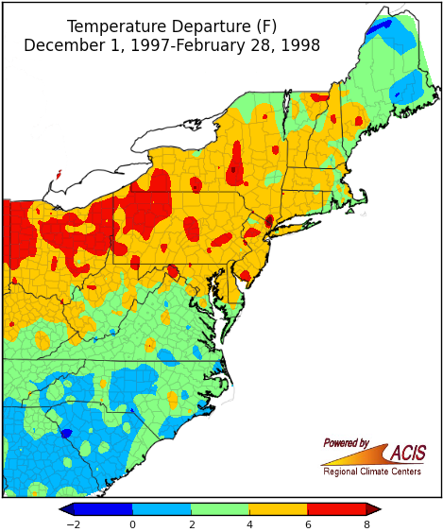
Notes:
Despite El Nino’s tendency to bring snowier-than-average winters to the East Coast, above-average temperature sled to below-average snowfall for most of the region. While the current El Nino is on track to be one of the strongest on record, please note that each El Nino is different.

Slide 5
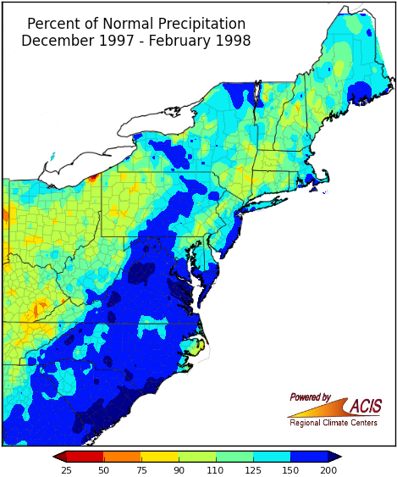

Slide 6
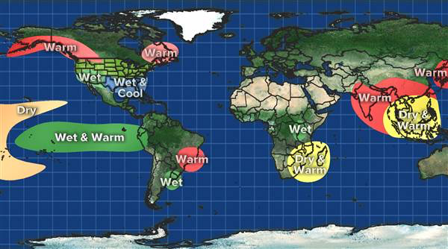

Slide 7
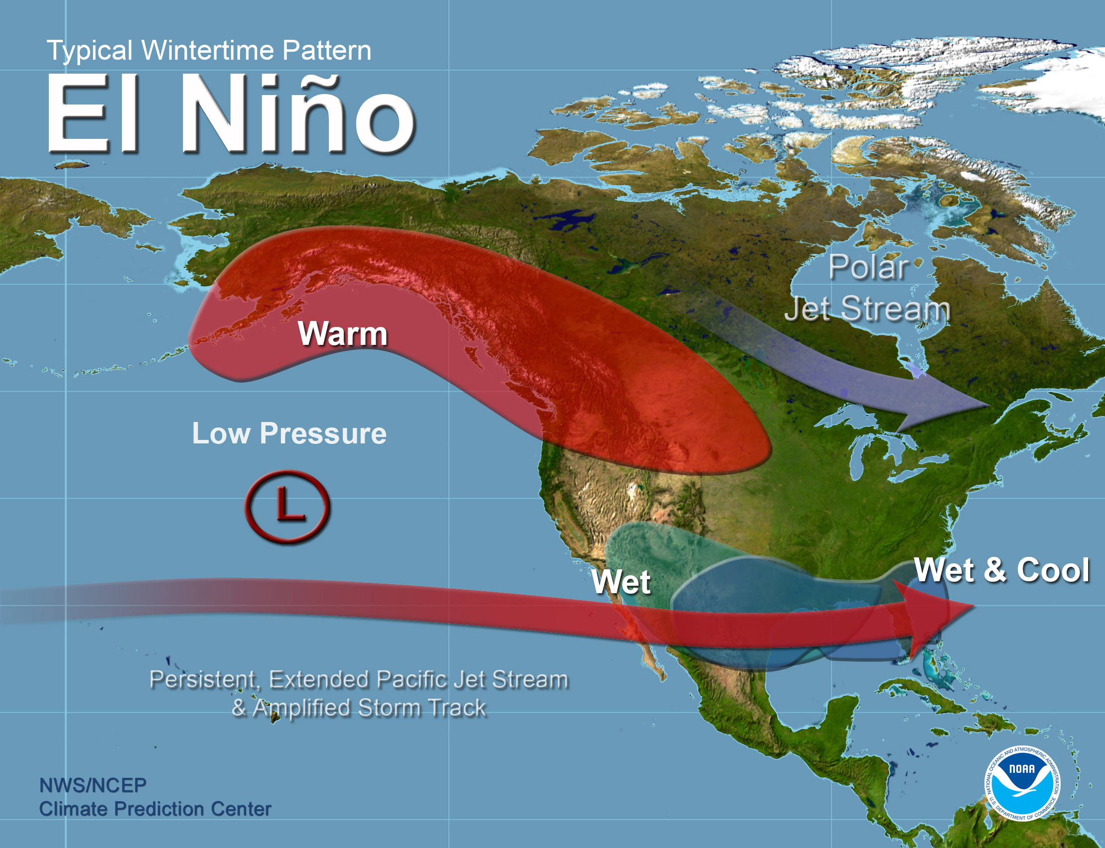
Notes:
Use Red to color the warm areas
Use Blue to color the cool areas
Use Yellow to color the wet areas.
Use your pencil to draw the Pacific Jet Stream and Polar Jet Stream and label each using the proper name.

Slide 8
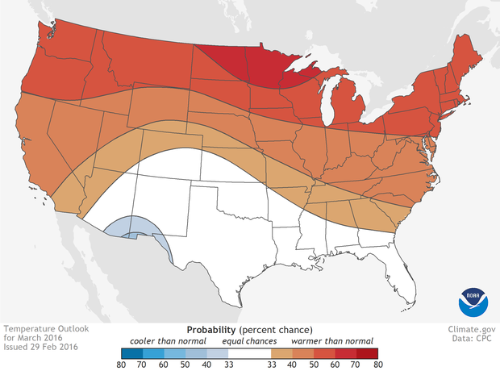
Temperature Outlook for March 2016
Notes:
El Niño is expected to affect seasonal climate across the United States during the upcoming months. There are increased chances that Mar-May will be wetter than usual across the southern U.S. and drier than usual over the Midwest and Pacific Northwest. Warmth is favored across the North and West, with cool conditions favored in the south-central U.S.

Slide 9
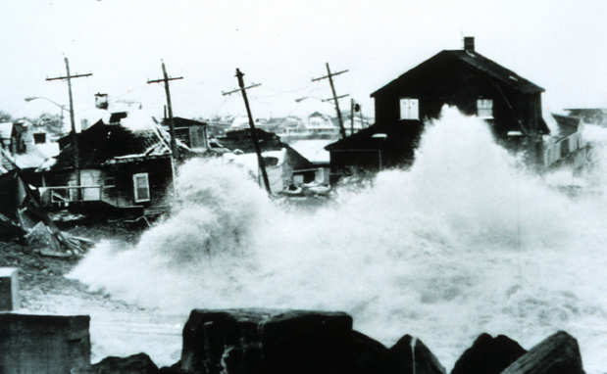
Coastal Storms
Notes:
Several research studies have noted an increased frequency of East Coast storms during El Nino winters. These storms, known as nor’easters, have a number of coastal impacts, ranging from beach erosion and high winds to heavy snowfall and precipitation. Storms that follow a classic nor’easter track from south of Cape Hatteras along the East Coast are the main contributor to this increase.
Significant snow storms such as
-blizzard of ’58
-A second blizzard in March 1958
-February 2003 Presidents’ Day Storm
- “Perfect Storm” in October 1991 brought 15 to 30 foot waves to coastal New England

Slide 10
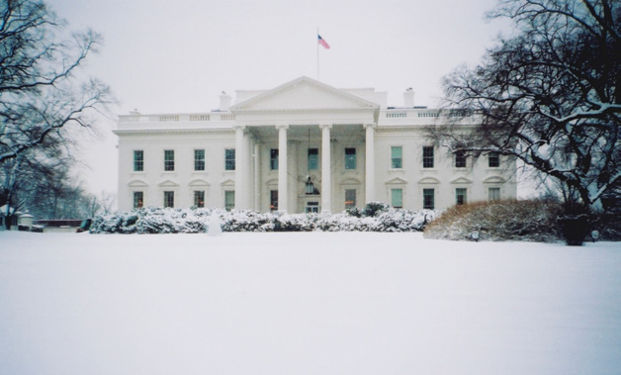
Snowfall
Notes:
Snowfall along the Northeast coast is typically above average during El Nino winters. Since 1950, six of the least snowy winters on record at Buffalo have occurred during El Ninos. Typically, in regions closer to the coast, December through February snowfall is as much as 6 inches greater during such winters. In Washington, DC, eight of the ten greatest 2-day snowfalls since 1950 have occurred during El Ninos.

Slide 11
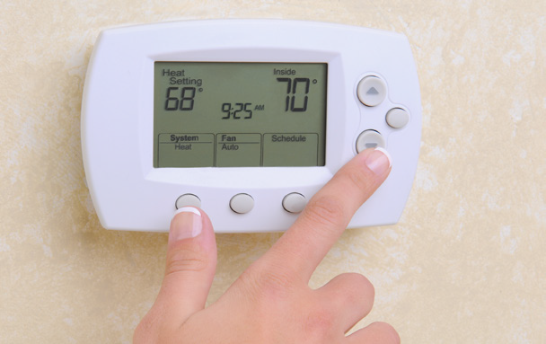
Energy Use
Notes:
Across a broad swath of the Southeast, El Nino winter temperature average 1 to 2 degrees cooler than those that do not experience El Nino conditions. Therefore, heating degree day accumulations tend to be higher during El Nino winters.

