Slide 1
Eclipses
Astronomy

Slide 2
Eclipses
Have you seen eclipses?
What are eclipses in nature?
One celestial object casts its shadow on the other one

Slide 3
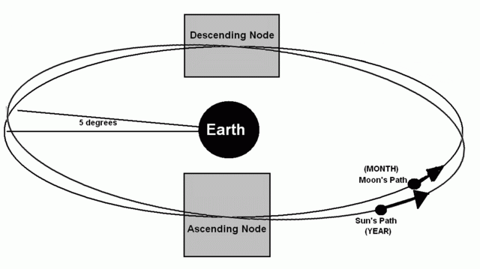
Moon’s Orbit
Why aren’t there solar eclipses and lunar eclipses on EVERY
new moon and full moon?
Because the moon’s orbit tilts 5°

Slide 4
Two conditions must be satisfied for an eclipse to occur
The nodes of the moon’s orbit must be nearly aligned with the Sun and the Earth
The phase of the moon must be new or full

Slide 5
Eclipses Cycle
Every year there are at least two lunar eclipses
Lunar eclipses and solar eclipses always come in pairs
Lunar eclipses can be seen everywhere on the earth, but the solar eclipses may only be seen on part of the earth

Slide 6
Solar Eclipses
Sun – the shadow of the moon on the earth
Occurs during the new moon
Total solar eclipse in 1999
http://www.timeanddate.com/eclipse/solar/2016-march-9

Slide 7
Solar eclipses
https://www.youtube.com/watch?v=_201ttTSG30

Slide 8
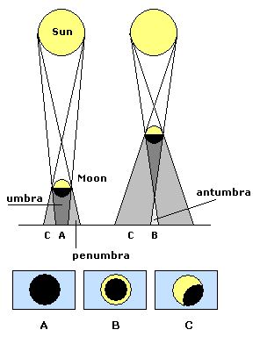
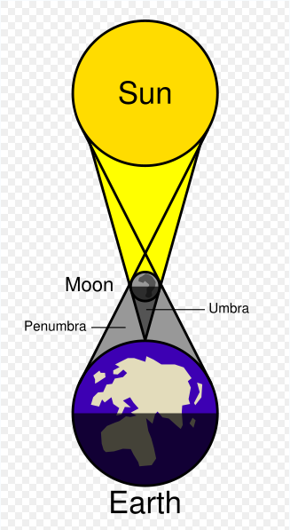
A – total eclipse
B – annular eclipse
C – partial eclipse

Slide 9
Lunar Eclipses
Moon – the shadow of the earth on the moon
Occurs during the full moon

Slide 10
Lunar Eclipses
https://www.youtube.com/watch?v=49O2MsT1txU

Slide 11
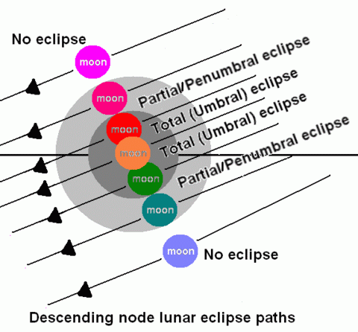
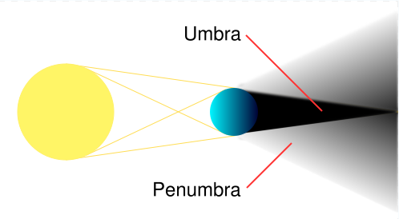
Lunar Eclipse

Slide 12
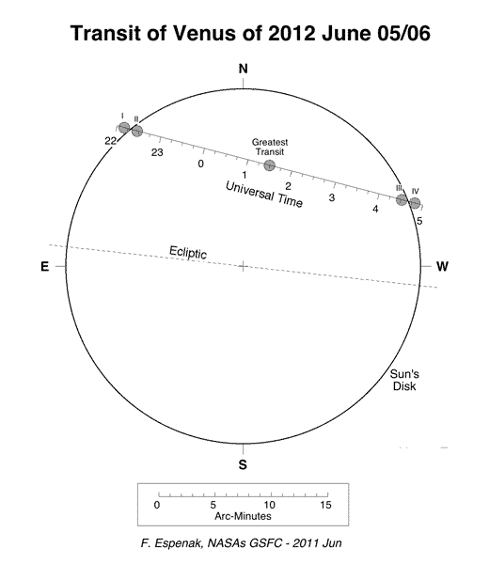
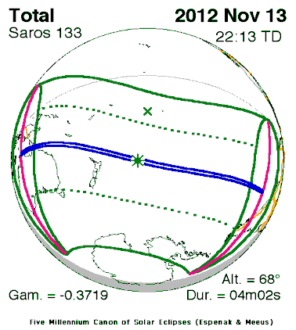
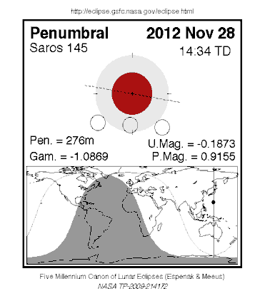
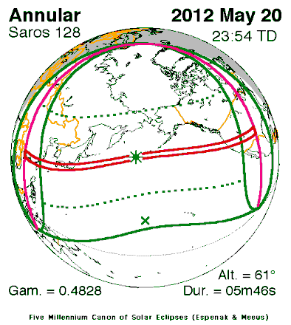
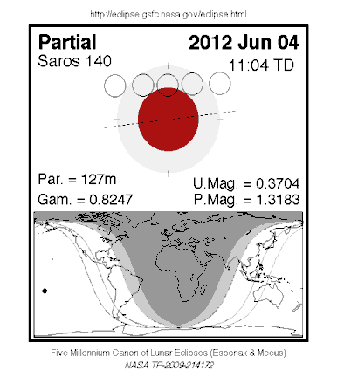
Eclipses and Transits of 2012
Annular Solar Eclipse of 2012 May 20 | Partial Lunar Eclipse of 2012 Jun 04 | Transit of Venus of 2012 Jun 05/06 | Total Solar Eclipse of 2012 Nov 13 | Penumbral Lunar Eclipse of 2012 Nov 28

Slide 13
Eclipses of 2017
http://www.timeanddate.com/eclipse/list.htm

