Slide 1
Life Processes
Life began in the ocean
Organisms need water for cell processes
Where does energy come from?

Slide 2
Photosynthesis
Chlorophyll containing organisms capture sunlight
They make food using sunlight, carbon dioxide, and water
These organisms start food chains
Coral reefs support biodiversity in warm shallow waters.
Which zone does this occur?
Equation?

Slide 3
Chemosynthesis
Bacteria perform chemosynthesis using chemicals
Occurs in the deep ocean along mid-ocean ridges at hydrothermal vents
These organisms also start food chains
http://video.nationalgeographic.com/video/hydrothermal-vents

Slide 4
Ocean Life
Plankton- tiny marine algae and animals that drift with the currents; most float in the epipelagic zone (why?)

Slide 5
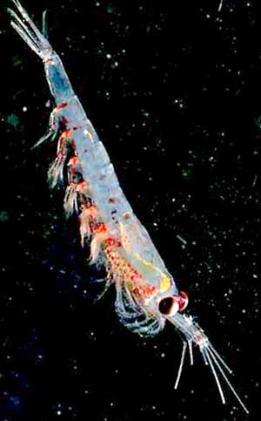
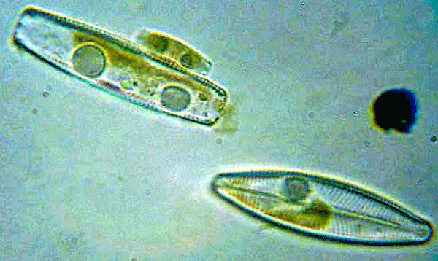
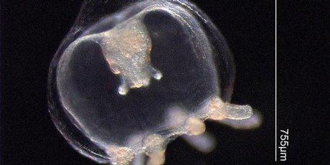
diatoms
Jellyfish larva
krill

Slide 6
Ocean Life
Nekton- animals that swim (rather than drift)
Examples?
Why do they move around?

Slide 7
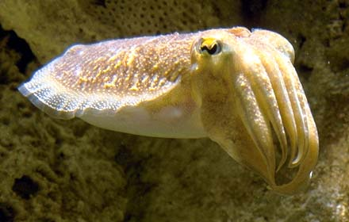
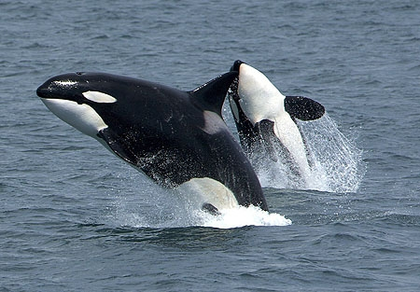
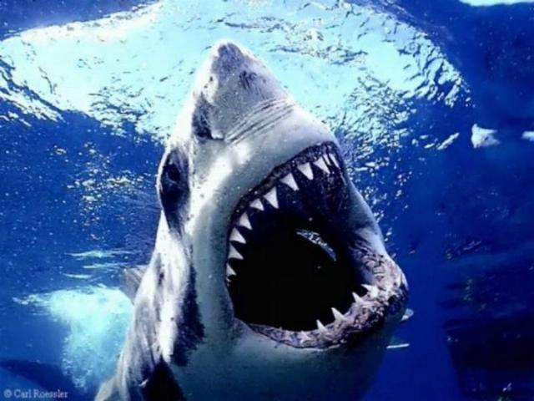
Squid
Orca (killer whale)
Great White shark

Slide 8
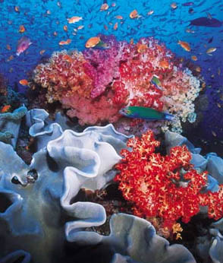
Ocean Life
Bottom dwellers- plants, algae, and animals that live on the seafloor
Called benthos
Examples: kelp beds, crabs, coral, snails, clams, etc

Slide 9
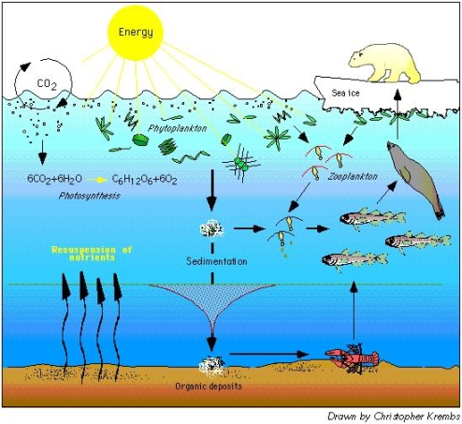

Slide 10
Biological Oceanography
Kelp forests exist where upwelling brings cold nutrient rich water
to surface.
https://www.youtube.com/watch?v=ICZsnzHY-Co

