Slide 2
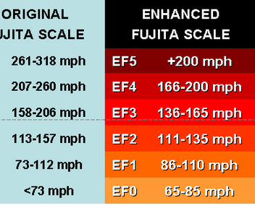
Tornado Classification
http://tornadoproject.com/cellar/fscale.htm
http://www.bing.com/videos/search?q=videos+of+tonadoes+at+different+scales&view=detail&mid=07CC2097336ECB60015907CC2097336ECB600159&FORM=VIRE

Slide 3
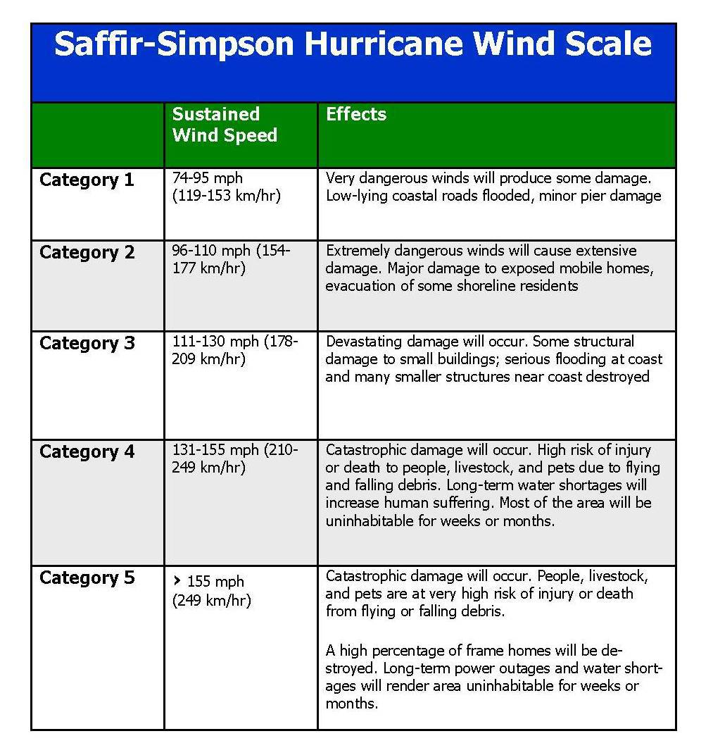
Hurricane Classification
US History
http://www.nhc.noaa.gov/outreach/history/
Strength
https://weather.com/storms/hurricane/video/hurricane-strength-by-the-numbers
Names
http://www.nhc.noaa.gov/aboutnames.shtml#atl

