Slide 1
World Agricultural Problems

Slide 2
Soil Erosion
Natural
Accelerated

Slide 3
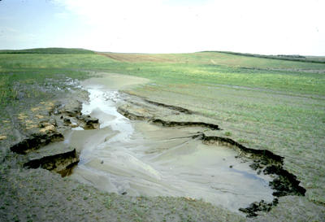
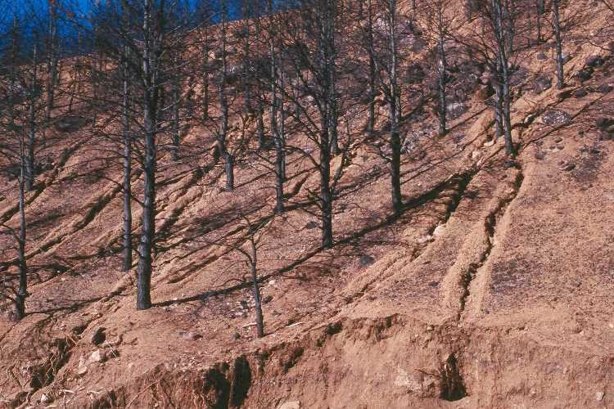
Types of Erosion
Sheet
Rill

Slide 4
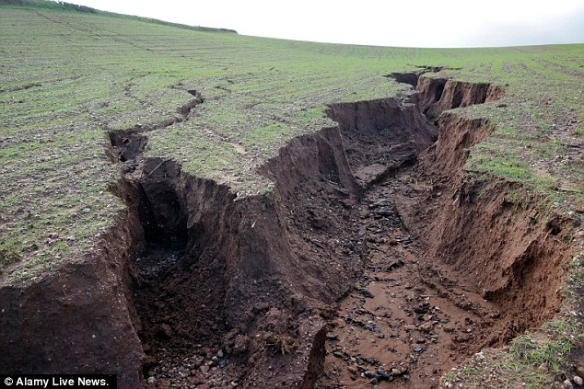
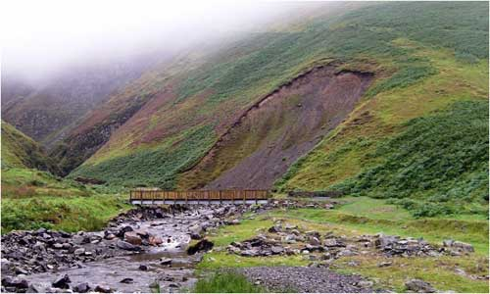
Types of Erosion
Gully
Mass

Slide 5
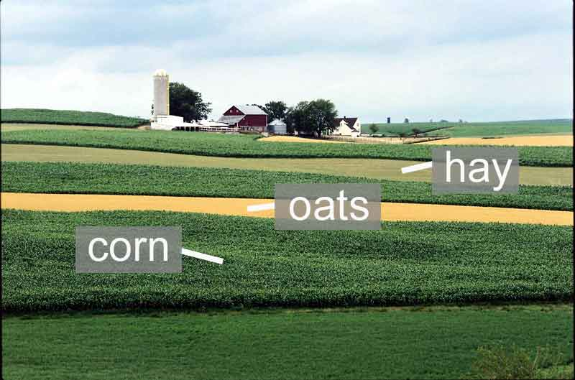
Soil Management – Erosion Control
Contour Farming
Strip Cropping

Slide 6
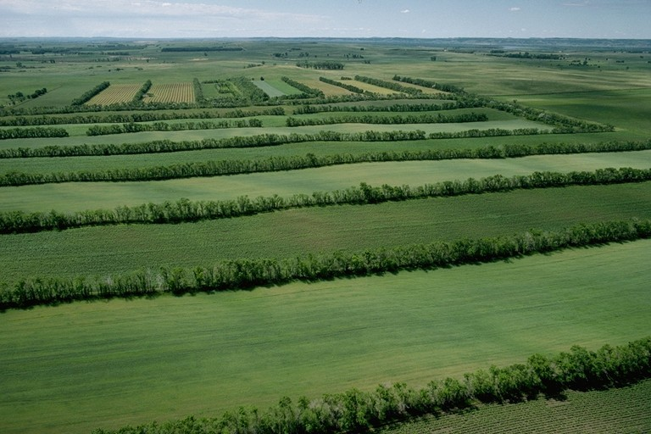
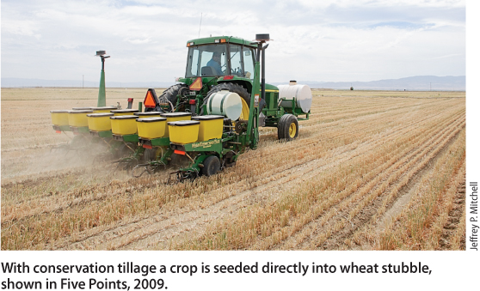
Soil Management – Erosion Control
Minimum (Conservation) Tillage
Windbreaks

Slide 7
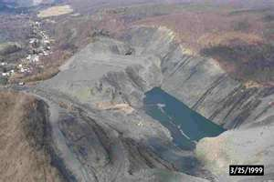
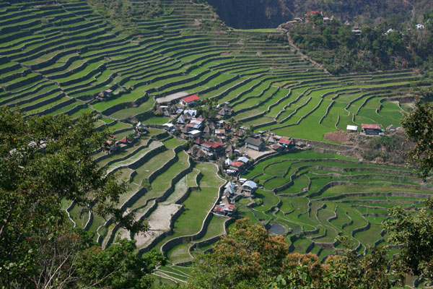
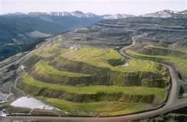
Soil Management – Erosion Control
Gully Reclamation
Terracing

Slide 8
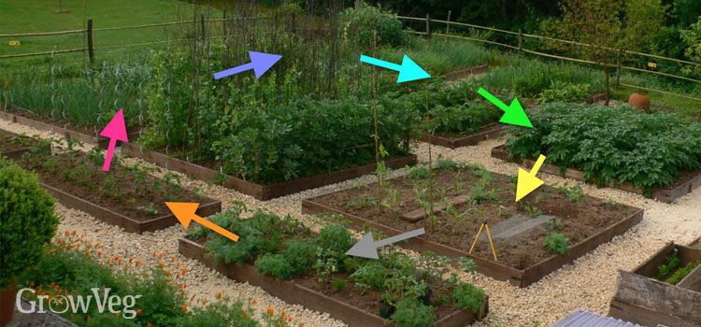
Soil Management – Erosion Control
Crop Rotation

