Slide 1
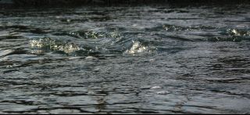
Weathering

Slide 2
What is Weathering?
Definition: process that breaks down rocks into smaller pieces called sediments.

Slide 3
What do you think is breaking down the rock in the following pictures?

Slide 4
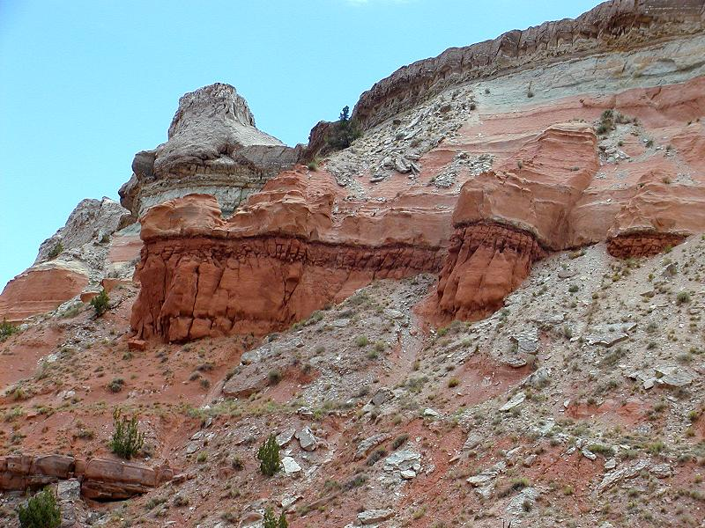
1

Slide 5
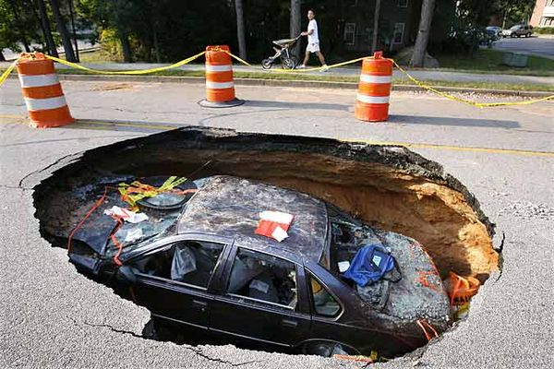
2

Slide 6
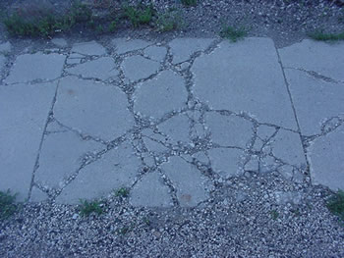
3

Slide 7
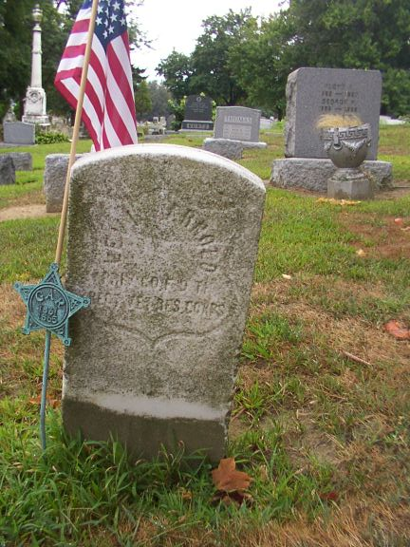
4

Slide 8
Evidence of weathering
Gritty dirt and stones by the sidewalk
Cracks and holes in streets and sidewalks
Blurred tombstones
Broken down statues
Older mountains are smaller and smoother

Slide 9
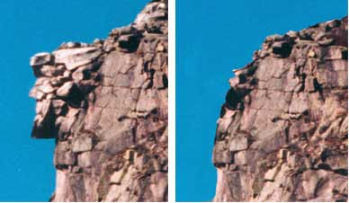
Before Weathering
After Weathering

Slide 10
Types of Weathering
A. Mechanical Weathering—breaking apart rocks without changing the chemical composition of the rock

Slide 11
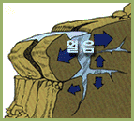
Types of Mechanical Weathering
Frost/Ice Wedging
Water seeps into cracks in rock
When water freezes, it expands
As ice expands, cracks are widened
Ice melts, finds more cracks, and freezes again

Slide 12
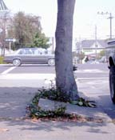
Types of Mechanical Weathering
Biological
Plants:
Roots grow into cracks of rocks
As roots grow, rocks are pushed apart
Pushing expands cracks
Animals:
Burrowing animals bring fresh rock particles to surface
Burrows allow air and water to penetrate the surface

Slide 13
Types of Mechanical Weathering
Temperature
When rocks heat up, they expand (grow)
When rocks cool down, they contract (shrink)
Constant heating and cooling causes cracks to form
Cracks spread quickly when temperatures change a lot

Slide 14
Types of Mechanical Weathering
Abrasion
Abrasion: scraping or wearing away
Rock fragments are carried along by wind or water, they collide and rub against another rock.
This breaks off small pieces.
Continued abrasion rounds edges.

Slide 15
Chemical Weathering
Chemical weathering—weathering that changes the chemical composition of a rock.

Slide 16
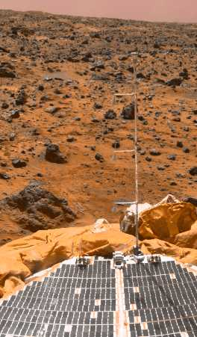
Types of Chemical Weathering
Oxygen
Oxygen combines with other substances in a chemical reaction called oxidation.
When oxygen combines with iron, rust is formed.
This weakens chemical bonds and breaks the rock.

Slide 17
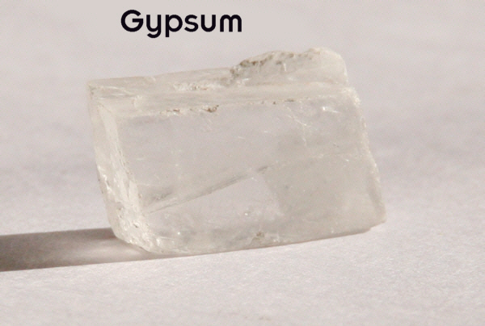
Types of Chemical Weathering
Water
Solution: Water can weather rock by dissolving minerals.
This will leave empty spaces.
Hydration: chemical reaction in which water combines with another substance to form a new mineral.
Hydrolysis: water can break apart minerals and combine with the parts.

Slide 18
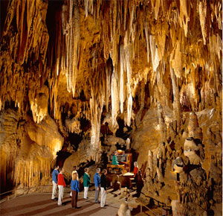
Types of Chemical Weathering
Carbon Dioxide
When water combines with CO₂, it forms carbonic acid.
Carbonic acid can dissolve some minerals such as calcite.
This can cause caverns.

Slide 19
Types of Chemical Weathering
Acid Rain
SO₂ and NO react with water and oxygen to create acid rain
Acid rain speeds up weathering and damages plant and animal life.
It corrodes manmade structures.
1908
1968

Slide 20
Factors that affect Weathering – things that will change the rate that weathering occurs.

Slide 21
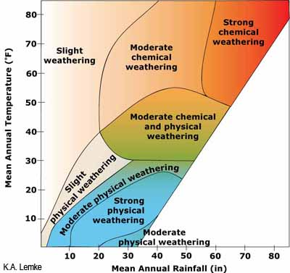
Factors that Affect Weathering
Climate
Warm, moist climates speed up weathering.
Cold climates favor ice wedging.
Dry climates experience very little weathering.

Slide 22
Factors that Affect Weathering
Mineral Composition
Rocks made of minerals that will react with acids, water and oxygen will weather quicker than minerals that are less reactive.

Slide 23
Factors that Affect Weathering
Exposure
The more exposed rocks have to air, water, and living things, the faster they weather.
Covering a rock slows weathering.
Rocks with two or more exposed surfaces will weather faster.

Slide 24
Factors that Affect Weathering
Time
The longer a rock is exposed to weathering processes, the more it is broken down.
Weathering is a slow process.
It can take hundreds to millions of years for a rock to weather.
Eventually, all rocks at Earth’s surface will be completely broken down by weathering.

Slide 25
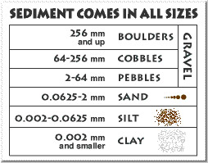
What Weathering Makes
Sediments
Sediments are fragments or particles of rock produced by weathering.
Sediments are named by their size.

Slide 26
What Weathering Makes
Soil
Weathering and plant growth change exposed rock and sediments into soil.
As soil forms, weathering and plant growth causes recognizable layers called horizons to form in the soil.

Slide 27
The Nature of Soil
Formation of soil – can take thousands of years
Soil is a mixture of weathered rock, decayed organic matter, mineral fragments, water, and air.
Formation is influenced by climate, slope, type of rock, types of vegetation, and length of time that rock has been weathering.

Slide 28
The Nature of Soil
Composition of soil – the ingredients that make up soil
Clay, silt, and sand are small particles of sediment.
Decaying, dark-colored plant and animal material is called humus.
Small spaces between soil particles may be filled with air or water.

Slide 29
The Nature of Soil
Soil Profile – made up of different layers of soil
Horizon A – top soil layer
May be covered with organic litter that may turn into humus
Fertile layer with more humus and less rock and mineral particles than other soil horizons.

Slide 30
The Nature of Soil
Horizon B – middle soil layer
Contains less humus and is lighter in color than A horizon.
Minerals travel from A horizon to B horizon in a process called leaching.

Slide 31
The Nature of Soil
Horizon C – bottom soil layer
Has very little organic matter and is not strongly affected by leaching
Contains rock – the parent material of the soil
Glaciers can deposit soil that did not form from the bedrock beneath it.

Slide 32
The Nature of Soil
Soil Types – differ in different places
Different regions have different climates that affect soil development.
Parent rock affects soil formation and type of vegetation that grows in a region.
Time affects soil development because the longer the weathering has occurred, the less the soil resembles the parent rock.
Soil on steep slopes develops poorly.

