Slide 1
Chapter 13
Clue’s to Earth’s Past

Slide 2
Fossils
Paleontologists study fossils and reconstruct the appearance of animals.
Fossils —remains, imprints, or traces of prehistoric organisms.
Fossils can form if the organism is quickly buried by sediments.
2. Organisms with hard parts are more likely to become fossils than organisms with soft parts.

Slide 3
Fossils
C. Types of preservation.
Fossils in which spaces inside are filled with minerals from groundwater are called permineralized remains.
Carbon film results when a thin film or carbon residue forms a silhouette of the original organism; carbonized plant material becomes coal.
Mold – cavity in rock left when the hard parts of an original organism decay.
If sediments wash into a mold, they can form a cast of the original organism.
Occasionally original remains are preserved in a material such as amber, ice, or tar.
Trace fossils– evidence of an organism’s activities
Can be footprints left in mud or sand that became stone
Can be trails or burrows made by worms and other animals

Slide 4
Fossils
Index Fossils– abundant, geographically widespread organisms that existed for relatively short periods of time
Fossils can reveal information about past land forms and climate.

Slide 5
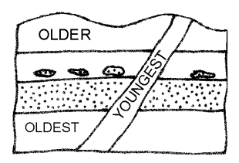
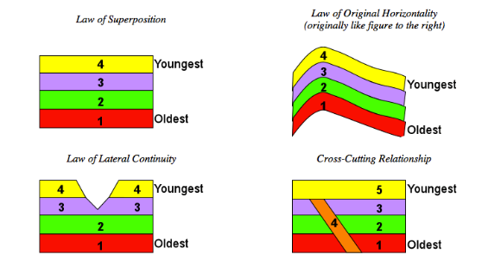
Relative Ages of Rocks
Principle of superposition —process of reading undisturbed rock layers
Oldest rocks in the bottom layer
Younger rocks in the top layer
How old something is in comparison with something else is its relative age.
The age of undisturbed rocks can be determined by examining layer sequences.
The age of disturbed rocks may have to be determined by fossils or other clues

Slide 6
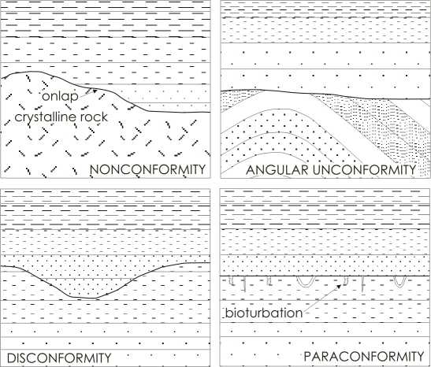
Relative Ages of rocks
Unconformities—gaps in rock layers
Angular unconformity—rock layers are tilted and younger sediment layers are deposited horizontally on top of the eroded and tilted layers.
A layer of horizontal rock once exposed and eroded before younger rocks formed over it is called a disconformity.
Nonconformity—sedimentary rock forms over eroded metamorphic or igneous rock
The same rock layers can be found in different locations; fossils can be used to correlate those rock layers.

Slide 7
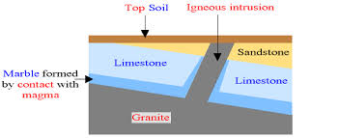
Relative Ages of rocks
E. Igneous intrusions occur when magma flows into already existing rock where it cools and hardens.

Slide 8
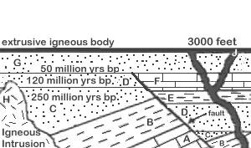
Relative Ages of rocks
F. Igneous extrusions occur when lava flows onto the earth’s surface and solidifies.

Slide 9
Absolute Ages of Rocks
Absolute age —age, in years of rock or other object; determined by properties of atoms
Unstable isotopes break down into other isotopes and particles in the process of radioactive decay.
Beta decay —an isotope’s neutron breaks down into proton and an electron with the electron leaving the atom as a beta particle; a new element forms due to proton gain.
Alpha decay —an isotope gives of two protons and two neutrons as an alpha particle; a new element forms.
The time it takes for half the atoms in an isotope to decay is the isotope’s half-life.

Slide 10
Absolute Age of Rocks
C. Calculating the absolute age of a rock using the ratio of parent isotope to daughter product and the half-life of the parent is called radiometric dating.
Potassium-argon dating is used to date ancient rocks millions of years old.
Carbon-14 dating is used to date bones, wood, and charcoal up to 75,000 years old.
Earth is estimated to be about 4.5 billion years old; the oldest known rocks are 3.96 billion years old.
D. Uniformitarianism - Earth processes occurring today are similar to those which occurred in the past.

Slide 11
Absolute Ages of Rocks
Discussion Question:
To determine the age of ancient rock, is it better to use potassium-argon dating or carbon-14 dating? Why?

Slide 12
Geologic Time
Chapter 14

Slide 13
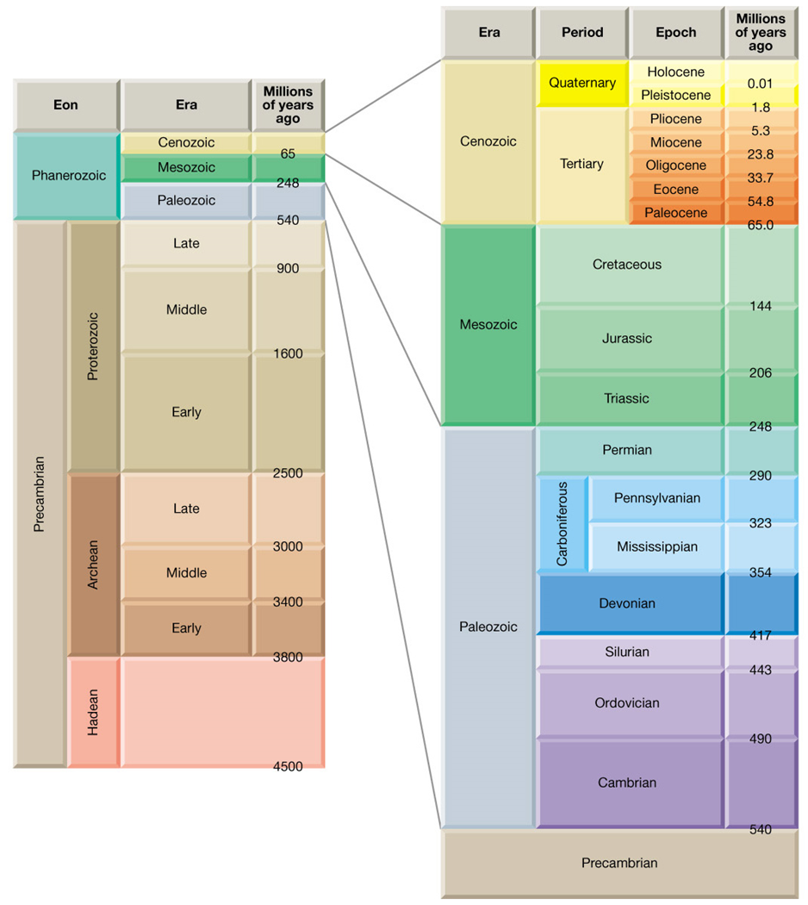
Life and Geologic Time
A. Geologic time—Earth’s history is divided into time units that make up a geologic time scale.
1. Time units on the scale are based on the appearance or disappearance of types of organisms such as trilobites index fossils that lived during specific periods of time.

Slide 14
Life and Geologic Time
2. Geologic time is divided into 4 major subdivisions.
Eons – longest subdivision; based on abundance of fossils
Eras – marked by significant worldwide changes in the types of fossils present in rock
Periods – based on types of life existing worldwide at a particular time
Epochs – characterized by differences in life-forms, but differences can be regional rather than global

Slide 15
Life and Geologic Time
3. Geological time can be subdivided only if fossils are present in rock records.

Slide 16
Life and Geologic Time
B. Organic evolution—Organisms have changed over time, most likely because of environmental changes.
Species—organisms that normally reproduce only with other members of their group.
Darwin’s theory of natural selection - organisms more adapted to an environment are more likely to reproduce.
Natural selection within a species occurs only if characteristics present in some numbers increase their survival.

Slide 17
Life and Geologic Time
4. Artificial selection - breeding individuals with desired characteristics; humans use this type of selection when breeding domestic animals.
5. New species can evolve from natural selection.

Slide 18
Life and Geologic Time
C. Trilobites – have an exoskeleton with three lobes; lived in oceans for more than 200 million years
1. Trilobite eye position changed as the species adapted to various environments.

Slide 19
Life and Geologic Time
2. Trilobite bodies and tails changed in response to changing environments.
3. Continental collisions formed the giant landmass Pangaea near the end of the Paleozoic Era. These collisions may have dropped sea levels, causing the extinction of trilobites.

Slide 20
Early Earth History
Precambrian time – from 4 billion to about 544 million years ago
Very few fossils remain from this time.
Many Precambrian rocks were deeply buried, causing the fossils in them to be changed by heat and pressure.
Most Precambrian organisms lacked hard parts.
2. Cyanobacteria are blue-green algae.
One of the earliest life forms to appear
Added oxygen to the atmosphere through photosynthesis
3. Invertebrates and Ediacaran animals appeared late in Precambrian time.

Slide 21
Early Earth History
B. The Paleozoic Era – about 544 million years ago to about 245 million years ago
Many organisms with shells and vertebrates evolved in the warm, shallow seas.
Amphibians evolved to survive in water and on land.
Might have evolved from fish
Could obtain oxygen from gills or from lungs.
3. Reptiles evolved from amphibians to survive farther from water .
4. Several mountain-building episodes occurred during the Paleozoic Era because of plate collisions.
5. Most marine and land species became extinct at the end of the Paleozoic Era.

Slide 22
Middle and Recent Earth History
Mesozoic Era – lasted form 245 to 65 million years ago
Pangaea separated into continents and the climate became drier.
Dinosaurs evolved; they might have been warm blooded, traveled in herds, and nurtured their young.
Birds, which probably evolved form small, meat-eating dinosaurs, appeared during the Jurassic Period.
Small, mouse-like mammals, which are warm-blooded vertebrates with hair and milk to feed their young, appeared in the Triassic Period.

Slide 23
Middle and Recent Earth History
Gymnosperms, plants that produce seeds but not flowers, appeared in the Paleozoic Era.
Flowering plants or angiosperms appeared during the Cretaceous Period.
A great extinction, perhaps caused by a comet or an asteroid collision, occurred about 65 million years ago, marking the end of the Mesozoic Era.

Slide 24
Middle and Recent Earth History
B. The Cenozoic Era began about 65 million years ago and continues today.
Many mountain ranges formed, perhaps creating cooler climates worldwide.
Mammals continued to evolve
Many species became isolated as the continents continued to separate.
Homo sapiens, or humans appeared about 400,000 years ago.

