Slide 1
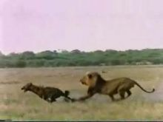
Relationships within Ecosystems
The who, what, where, when, why of it all.

Slide 2
Niche
The unique role a species has within an ecosystem.
(Dung Beetle)
African Dung Beetle - YouTube

Slide 3
Habitat
Where an organism generally lives within an ecosystem.
http://www.youtube.com/watch?v=PNgGBemdnuw

Slide 4
Competition
When species attempt to use the same resources.
Food
Water
Shelter
http://www.youtube.com/watch?v=H-wCX5R8NXM&feature=related

Slide 5
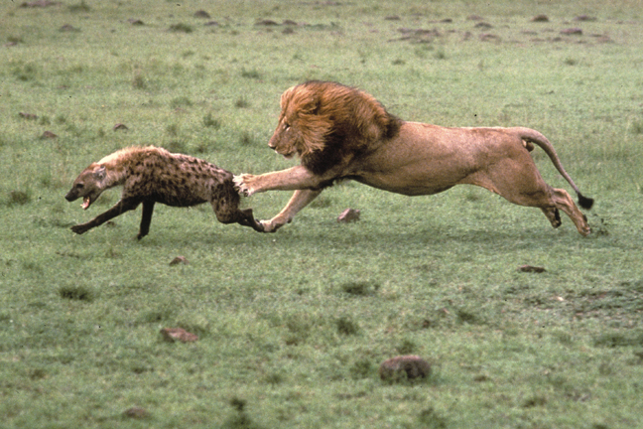
Different types of competition
Interspecies -
2 or more different species competing for resources.
Ex lion vs. hyena
http://www.youtube.com/watch?v=x49NwjnwDUw

Slide 6
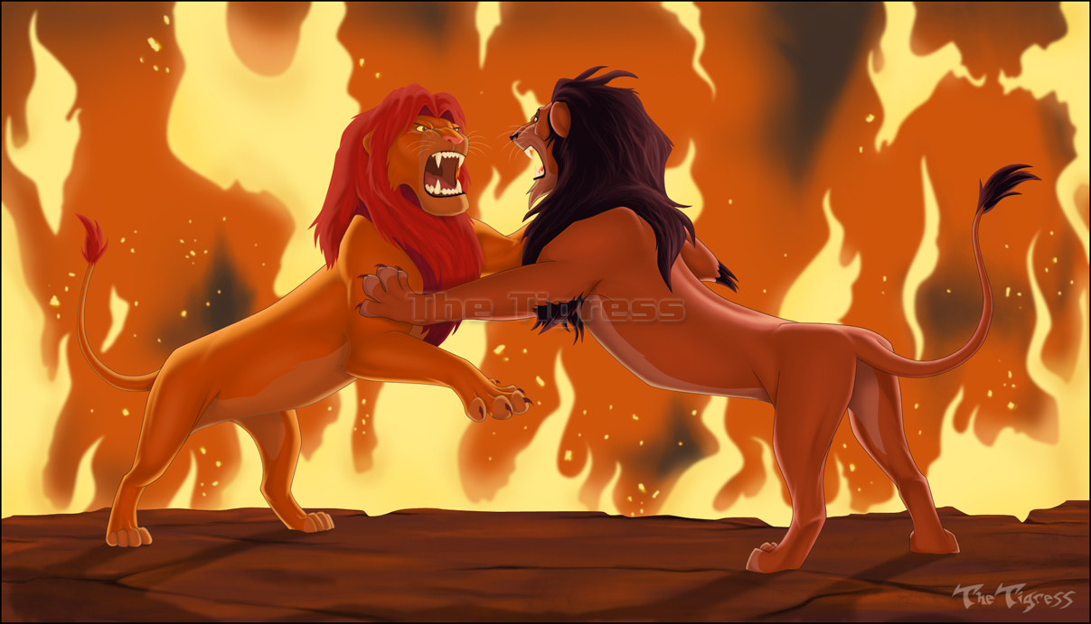
http://www.youtube.com/watch?v=2vZLmGudqPE
Intraspecies
2 of the same species fighting over resources
Ex. lion vs. lion

Slide 7
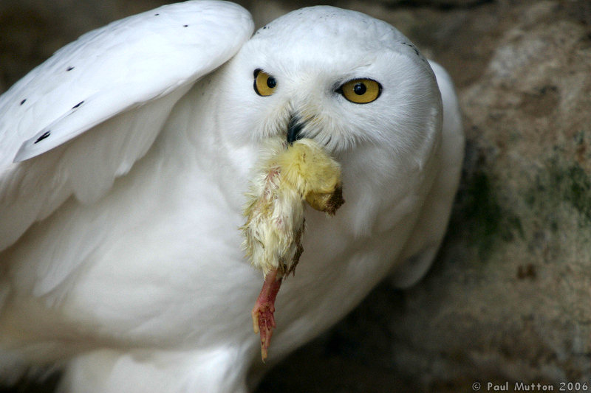
Predation
A Predator vs. prey relationship.
Predator eats the prey.
The prey is the food for the predator.
http://www.youtube.com/watch?v=6hGuallLPcM

Slide 8
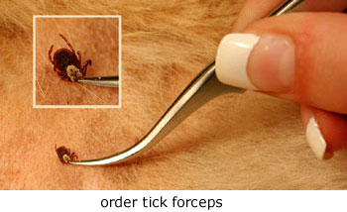
Parasitism
The parasite takes nourishment from the host.
The host is harmed in the relationship, often weakened and exposed to disease.
http://www.youtube.com/watch?v=02Tlzapl8ig

Slide 9
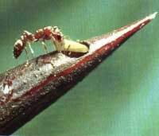
Mutualism
Each organism benefits in the relationship.
The acacia tree and ants -
Tree provides food and shelter
Ant provides protection from predators
http://www.youtube.com/watch?v=Xm2qdxVVRm4

Slide 10
Commensalism
One organism benefits and the other is indifferent or unharmed.
Whale shark and remora fish.
http://www.youtube.com/watch?v=e4xrdeagyYM

Slide 11
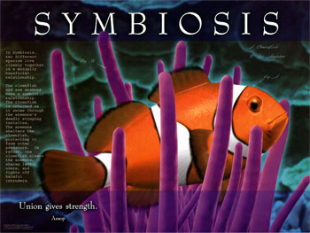
Symbiosis
A relationship in which two different organisms live in close association with each other.

Slide 12
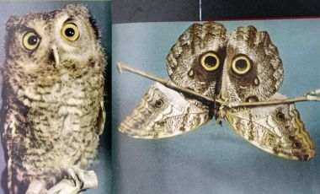
Mimicry
Acting or looking like another more dangerous animal.

Slide 13
Question #1
What does a parasite get from its host?
nourishment

Slide 14
Question #2
Why is it beneficial for the parasite to let its host live?
It then receives an unlimited supply of food and a place to live.

Slide 15
Question #3
What is the name of the relationship when species A benefits and species B is killed.
Predation

Slide 16
Question #4
What is the name of the relationship when species A and B positively affect each other?
Mutualism

Slide 17
Question #5
What is the name of the relationship when species A and species B negatively affect each other?
Competition

Slide 18
Question #6
What is the name of the relationship when species A benefits and species B is unaffected?
Commensalism

Slide 19
Question #7
What is the name of the relationship when species A benefits and species B is harmed but not killed?
parasitism

Slide 20
Question #8 What is the relationship?
Lion and antelope
Whale shark and remora fish
Tapeworm and humans
A bee pollinating a flower and drink the nectar as well
All the animals at a watering hole
Predation
Commensalism
Parasitism
Mutualism
Competition

