Slide 1
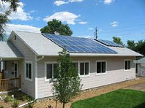
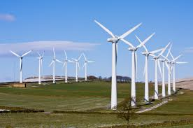
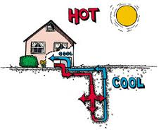
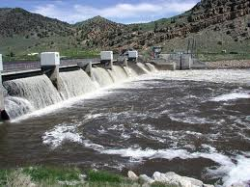
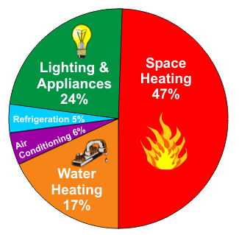
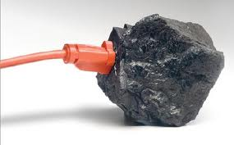
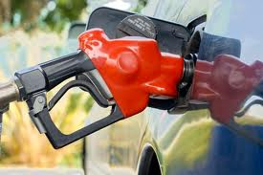
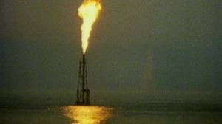
Energy Resources

Slide 2
Let’s take a trip to Iceland…

Slide 3
Why are we going to Iceland to study energy?
http://www3.nationalgeographic.com/places/countries/country_iceland.html

Slide 4
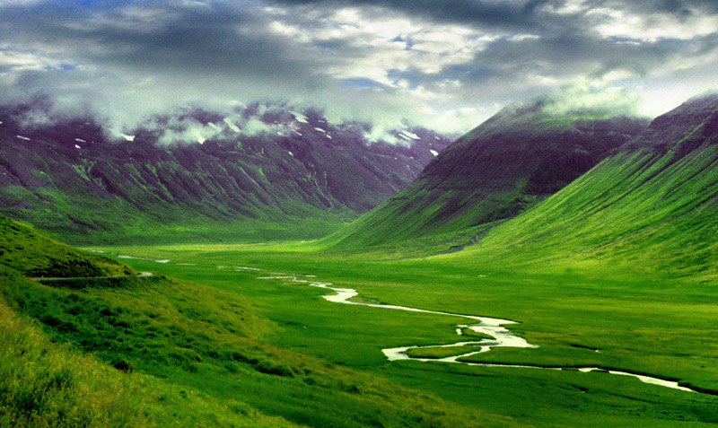
Volcanic Valleys

Slide 5
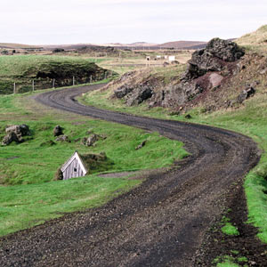
Volcanic Rock Roads

Slide 6
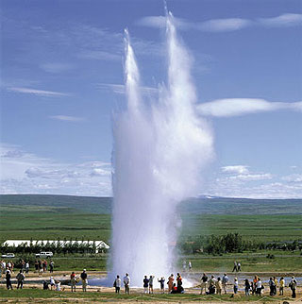
Geothermal Geysers

Slide 7
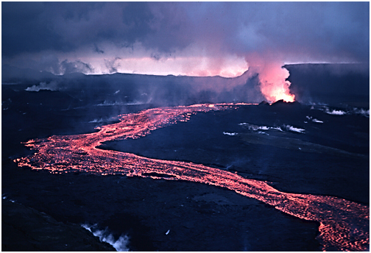
Active Volcanoes

Slide 8
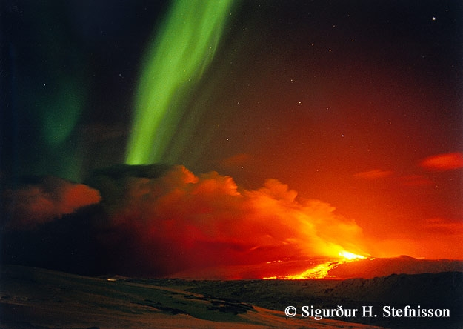
Northern Lights

Slide 9
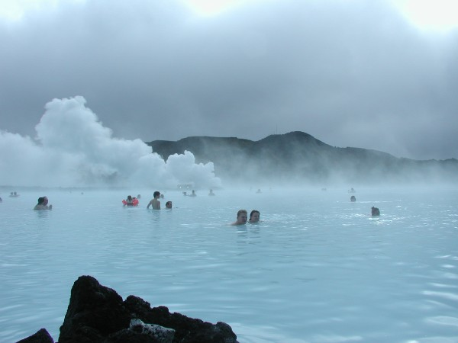
Thermal Springs

Slide 10
Energy is the ability to do work. Natural Resources are used to create energy for many human needs and wants

Slide 11
2 Types of Energy
Nonrenewable Energy is energy that cannot be
created in our lifetime (think about 100 years).
Examples: nuclear, coal, oil, natural gas
Renewable Energy is energy from sources that
are constantly being formed.
Examples: Wind, Solar, Water (hydro),
Geothermal, Biomass, Hydrogen

Slide 12
Nonrenewable Energy
Most of the energy we use comes from a
group of natural resources called fossil
fuels.
These are the remains of ancient organisms
that have changed into coal, oil, or natural
gas.

Slide 13
Problems with Fossil Fuels
Supply is limited.
2. Obtaining and using them causes negative impacts on the environment.

Slide 14
Fossil Fuels are used for:
Transportation
Manufacturing
Heating and Cooling buildings
Generating Electricity to run machines and appliances

Slide 15
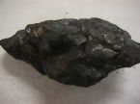
COAL

Slide 16
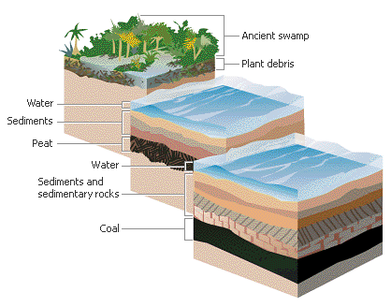
How Coal Forms… from ancient remains of plants millions of years ago

Slide 17
Coal Pros
High grade coal produces more heat and less pollution
Helps recycle carbon
Inexpensive
Needs little refining after mining

Slide 18
Coal Cons
Burning releases pollutants into air
Toxic chemicals can leach into streams near mines
Increase sulfur in air (Acid Rain)
Mining coal removes top layers of soil (Erosion)

Slide 19
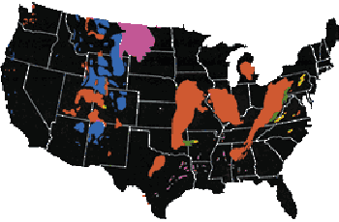
Coal Mining occurs mostly in these areas of the United States

Slide 20
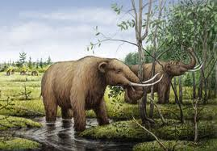
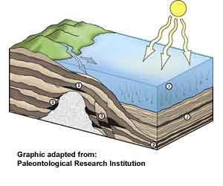
Oil and Petroleum… forms from ancient remains of plants and animals millions of years ago

Slide 21
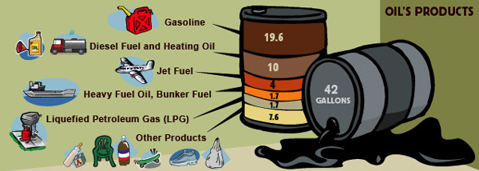
PETROLEUM / OIL
Used for FUEL!
Also creates plastics, clothing, paints

Slide 22
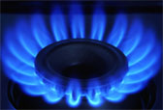
Natural gas…always found with oil
Used for cooking and heating

Slide 23
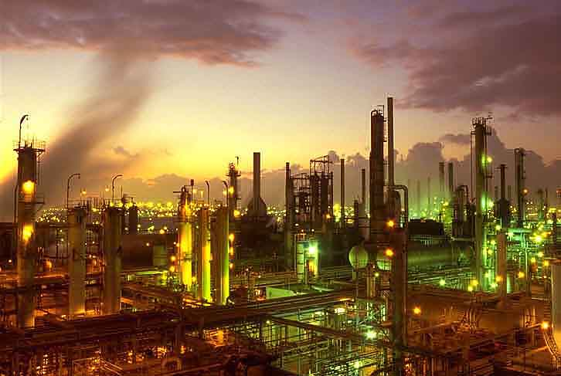
Refinery…changes oil into… gas, plastics, clothing, etc.

Slide 24
Air Pollution from burning fossil fuels

Slide 25
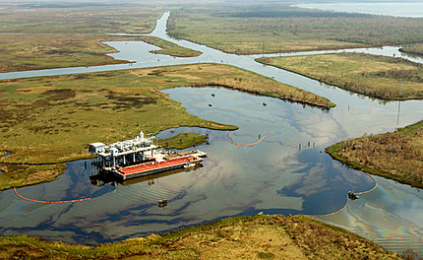
Water polluted with fossil fuels

Slide 26
The effects of Acid Rain from burning fossil fuels

Slide 27
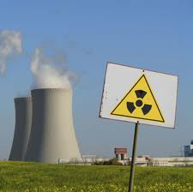
NUCLEAR POWER: Nuclear fission to create a very concentrated energy source with little air pollution

Slide 28
Nuclear Pros
1. Very Concentrated Energy Source
2. No air pollution
3. Releases less radioactivity than coal fired
plants
4. Good for countries with limited fossil fuel

Slide 29
Nuclear Cons
1. Building and maintaining a safe reactor is
Expensive
2. Radioactive Waste storage
3. Safety concerns from Radiation leaks
4. Mining of uranium

Slide 30
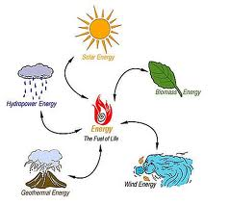
Renewable Energy:
constantly being formed

Slide 31
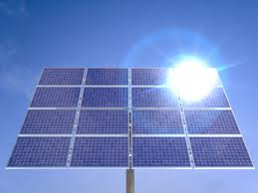
SOLAR ENERGY

Slide 32
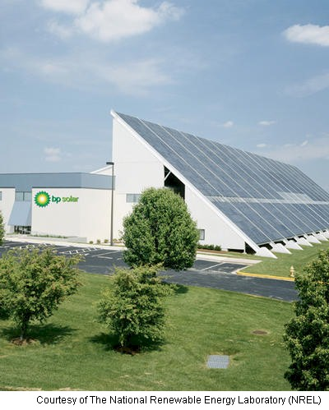

Slide 33
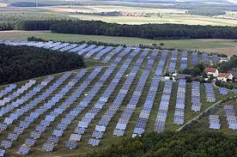

Slide 34
Solar Pros
Excellent for heating water
Less expensive
Great for developing countries
No Pollution
Available in most parts of the world

Slide 35
Solar Cons
Winter sunshine less common in some areas
Inefficient
Freezing damages panels
Can’t operate on rainy days
Needs lots of space

Slide 36
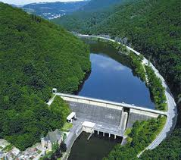
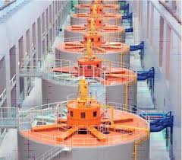
HYDROELECTRIC POWER

Slide 37
Hydro Pros
Inexpensive to run
No air pollution
Last longer than fossil fuels
Dams can be used for
Flood control
Drinking water
Recreation

Slide 38
Hydro Cons
Expensive to build
Dams block river flow
Ecosystem below dam is disrupted
Prevents fish from swimming up stream
If dam breaks, flooding can destroy towns
Need lots of space

Slide 39
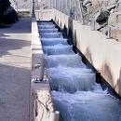
Fish Ladder

Slide 40
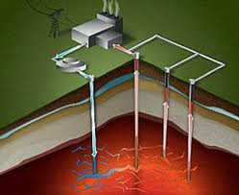
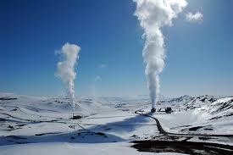
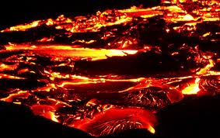
Geothermal Energy
Almost all of Iceland's
electricity and heating come from geothermal power plants.

Slide 41
Geothermal Pros
Less pollution
2. Less expensive to maintain

Slide 42
Geothermal Cons
1. Not everywhere
2. Expensive to build

Slide 43
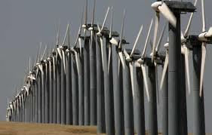
Wind Energy…Fastest Growing Energy Source for Electricity in the World!

Slide 44
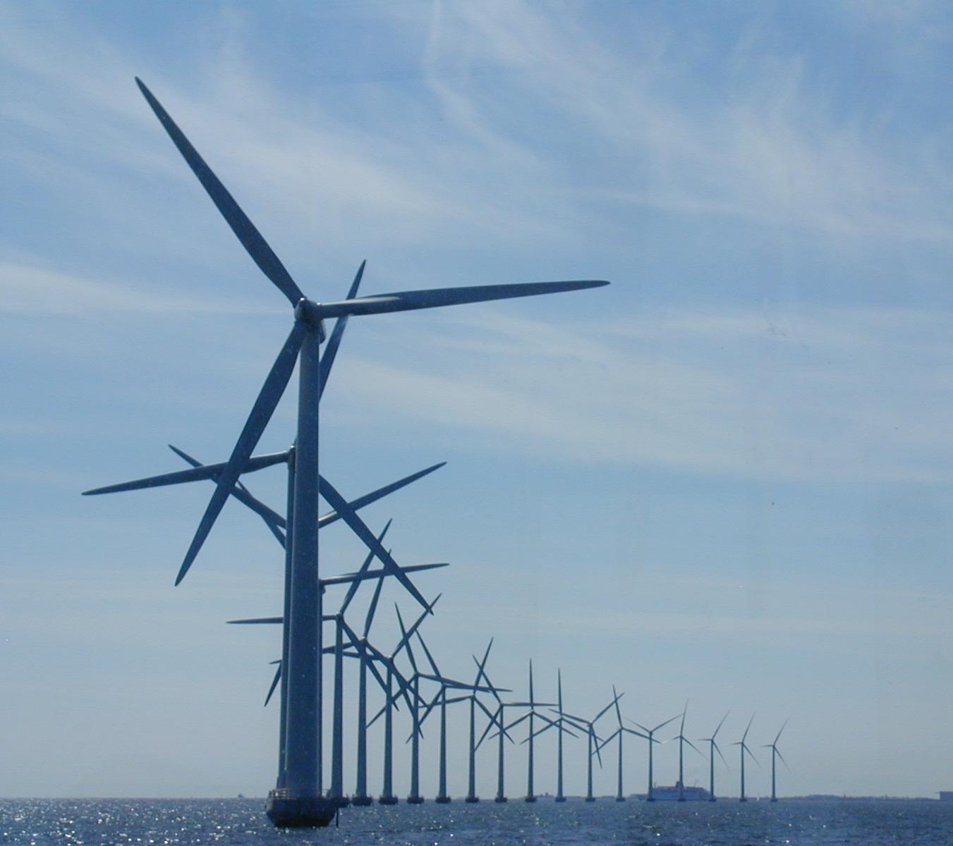
Wind Farms

Slide 45
Wind Pros
1. Abundant
2. Cost effective

Slide 46
Wind Cons
1. Transporting electricity from rural
areas where it is generated to urban
centers where it is needed is difficult
2. Ecosystem disruptions for birds
3. Noisy

Slide 47
Biomass is…natural resources!
Biomass is any non-fossil type of natural
resource that can be burned for energy.
Examples:
1. trees,
2. crops
3. municipal solid waste (trash)
4. animal wastes,

Slide 48
Sources of biomass energy
wood
woodchips
paper
trash
corn
sugar cane
canola
sunflower
soybeans
grains
animal waste
sewage
food scraps
hemp
straw
vegetable oil
algae

Slide 49
Biomass Pros
Available to developing countries
Waste from cows can be burned
Can be used to make ethanol for cars
Less air pollution than fossil fuels

Slide 50
Biomass Cons
Increases Acid Rain
More Carbon Dioxide
Deforestation = Habitat Loss
Growing corn for fuel instead of food

