Slide 1
Climate and Climate Change

Slide 2
Climate and Climate Change
Objectives:
describe the transfer of energy between atmosphere, land masses, and oceans
describe differential heating and cooling
describe oceanic and atmospheric circulation patterns
describe climates and microclimates

Slide 3
Climate and Climate Change
Important Vocabulary:
climate
weather
microclimate
latitude
differential heating and cooling

Slide 4
Climate
Climate is the long-term prevailing conditions at a particular place taken over time and based on records taken.
Includes average temperature and precipitation over time.

Slide 5
Weather
Weather is the current atmospheric conditions at a given time.

Slide 6
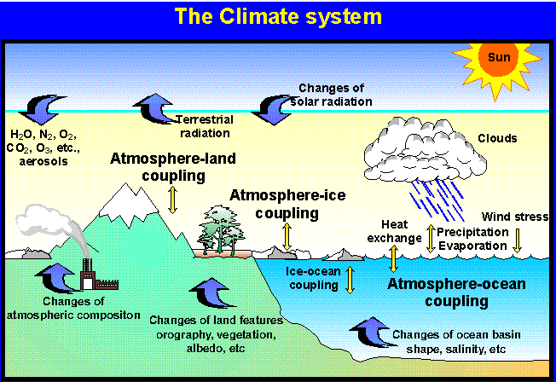
Factors that Determine Climate
1. Latitude
2. Atmospheric circulation patterns
3. Oceanic circulation patterns
4. Geography of an area
5. Solar activity

Slide 7
Latitude
Latitude is the distance from the equator measured in degrees north or south.

Slide 8
Latitude
Light rays strike the earth more directly at the equator so the equator is warmer than areas in the northern and southern hemisphere where the sun strikes the earth at an angle.

Slide 9
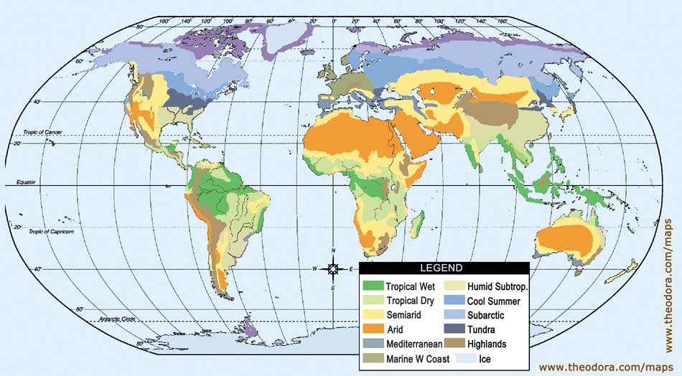
REMEMBER THIS!!!
Weather
Weather is the atmospheric conditions on a given day.
Climate is the long term weather conditions determined by temperature and precipitation.
Climate

Slide 10
Microclimate
A local atmospheric zone where the climate differs from the surrounding area is known as a microclimate.
A microclimate exists inside the bird of paradise flower. The temperature is very different on the inside compared to the outside of the flower.

Slide 11
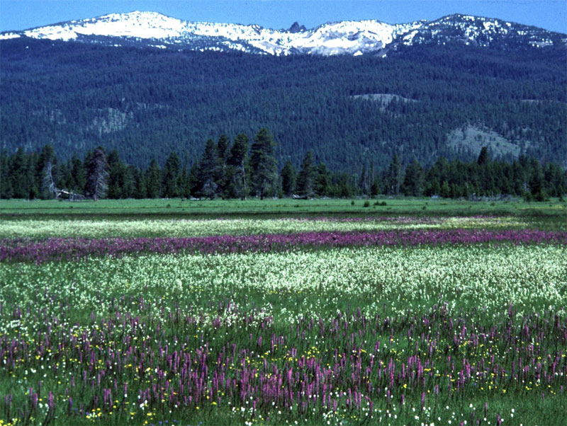
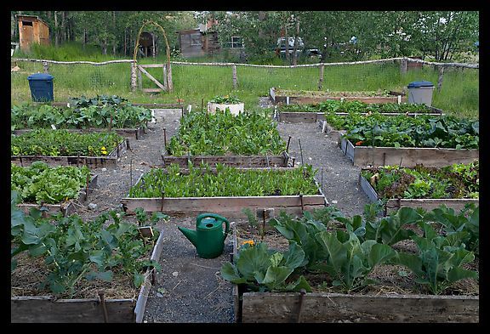
Microclimates
The term may refer to areas as small as a few square feet or as large as many square miles.
gardens
valleys

Slide 12
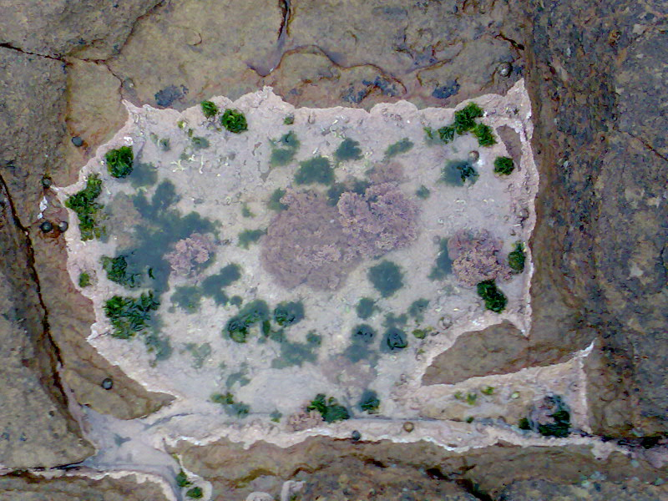
More Examples of Microclimates
Bodies of water may cool the local atmosphere and create a microclimate.
Heavily urban areas where brick, concrete, and asphalt absorb the sun's energy, heat up, and reradiate that heat to the ambient air
The resulting urban heat island is a kind of microclimate.
Microclimate on a rock

Slide 13
Factors that affect Climate and Weather
Land masses and oceans (nearness to oceans)
Number of days and hours of sunlight
Air circulation patterns (direction of winds)
Differential heating and cooling
Oceanic circulation patterns

Slide 14
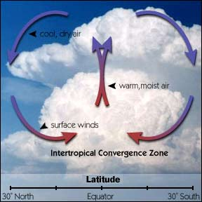
Air Circulation Patterns
Cold air sinks because it is more dense than warm air.
- cold air sinks and then warms
- warm air rises, expands and then cools.
When warm air cools, water vapor may condense to form rain, snow, or fog.

Slide 15
Oceanic Circulation Patterns
El Nino - winds in the western pacific strengthen and push warm water eastward.

Slide 16
Oceanic Circulation Patterns
La Nina – Cool water in the eastern pacific gets pushed westward. It is the opposite phase of El Nino

Slide 17
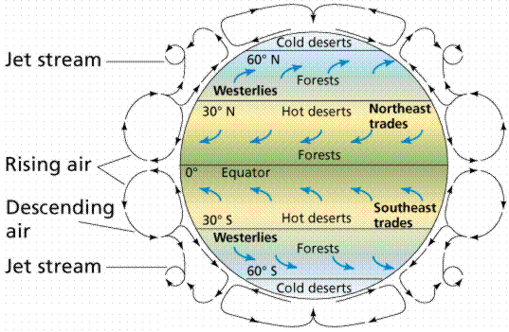
Oceanic Circulation Patterns
As El Nino brings in warm water eastward, and La Nina brings in cool water, the air temperature above is affected and thus affects the temperature on land.

Slide 18
REMEMBER THIS!!!
Nearness to large bodies of water and ocean currents affects climate.
Climate determines where plants grow.
Climate is determined by long range temperature and precipitation patterns.
Climate determines which organisms are found in a particular area.

Slide 19
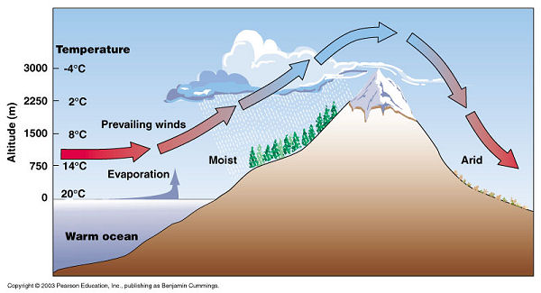
Land Masses and Oceans
Wind blowing over water creates a rainshadow effect.

Slide 20
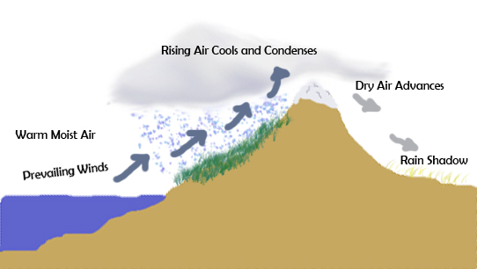
Rainshadow Effect
An area having relatively little precipitation due to the effect of a barrier, such as a mountain range, that causes the prevailing winds to lose their moisture before reaching it.
It rains a lot on the side of the mountain near the body of water, but is dry on the inland side of the mountain.

Slide 21
Differential Heating and Cooling
Land masses heat up more quickly and cool more quickly than large bodies of water.

Slide 22
Differential Heating and Cooling
Have you ever taken a walk on the dry beach on a sunny day?
Did you find that in the early afternoon the sand was much warmer than the water?
That’s differential heating and cooling!
Water is a slow conductor of heat, thus it needs to gain more energy than the sand or dry land in order for its temperature to increase.
On the other hand, soil loses its heat much faster.
But your toasted toes would perhaps mislead your mind!

Slide 23
Differential Heating and Cooling
Earth's oceans are far more important than the land as a source of the heat energy which drives the weather.
Not only do the oceans cover more than 2/3 of the Earth's surface, they also absorb more sunlight and store more heat than land.
Additionally the oceans retain heat longer.
The Sun's rays also penetrate the oceans to a depth of many meters, but only heat up the top layer of the sand or soil.
Water has to lose more energy than the sand (dry land) in order for the temperature to decrease.

Slide 24
REMEMBER THIS!!!
Differential Heating and Cooling:

Slide 25
THE END!!!

