Slide 1
Chapter 24
Stars and Galaxies

Slide 2
Stars
Constellations — groups of stars
Greeks named most of them
Sky is divided into 88 of them

Slide 3
Stars
Sirius — brightest star in the sky
Polaris (north star)—above north pole
it’s the only star that doesn’t appear to move

Slide 4
Brightness
Absolute magnitude —how much light the star is actually giving off
Quasars —the brightest objects known

Slide 5
Brightness
Apparent magnitude —how much light reaches the Earth
Stars appear brighter when they’re closer
Quasars appear very dim, because they’re all very far away

Slide 6
Distances to stars
Light years —distance light travels in one year
9.5 trillion km
Proxima Centauri is the closest, at 4.2 light years
Parallax —apparent shift of a star’s position when viewed from different places
Used to measure distances to some stars

Slide 7
Temperature and composition
Temperatures are different for different colored stars
Blue-white —hottest
Yellow —average
Red —coolest
Composition of a star can be determined from the specific colors it gives off

Slide 8
The Sun
99% of the solar system mass is in the sun
All processes on earth are possible because of the energy from the sun
Average middle-aged star
Odd that it’s single
Most stars occur in pairs called binary stars
Larger groups of stars are called clusters
Pleiades cluster

Slide 9
The sun’s atmosphere
Core —where the energy is produced by nuclear fusion
Photosphere —outer layer where the light actually comes out
“surface of the sun”
Corona —largest, outermost layer, extending out into space
“atmosphere of the sun”

Slide 10
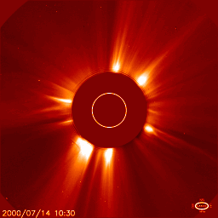
Sun’s Surface Features
Sunspots —cool, darker spots on the surface
Move across as the sun rotates
Occur in large quantities every 11 years
Prominence —huge arching column of gas
Flare —outward eruptions near sunspots

Slide 11
Star Evolution
H-R Diagram
Comparison of surface temperature and absolute brightness
For most stars, as temp. increases, so does absolute brightness
Main Sequence —area encompassing most stars
White dwarfs —very hot, but not very bright
Red Giants —very bright, but not very hot

Slide 12
What powers stars?
If stars were just burning like wood, they would burn out very quickly
Stars fuse light elements into heavier ones
Mostly Hydrogen into Helium

Slide 13
What powers stars?
In the process, a very little mass is lost
Very little mass turns into a lot of energy, according to E = mc²
E = energy
m = mass
c = speed of light

Slide 14
A star is born!
Stars form from nebula
Gas collects and starts to heat
When it starts to glow from the heat, it is a protostar
When fusion starts in the core (at about 10 million degrees) it’s a star

Slide 15
As Hydrogen-Helium fusion occurs, it’s a main sequence star
How long it lives and how it dies is determined on its mass
Heavier stars burn hotter, burn out faster, and die more violently

Slide 16
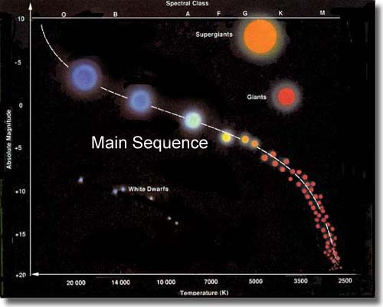

Slide 17
Death in its many forms
Most stars, like ours:
Becomes a red giant
Sheds outer layers, forming a nebula
exposing the dense, hot core, called a white dwarf

Slide 18
Death in its many forms
Stars more than 10 times the mass of the sun:
Becomes a red supergiant
Explodes in a supernova, forming a nebula
Core compresses to a neutron star (1 big atomic nucleus) or a black hole

Slide 19
Crab Supernova
Visible Light
X-rays

Slide 20
Galaxies
Galaxies are large groups of stars, gas, and dust held together by gravity
Our sun is one star
The sun and planets make up our solar system
Our solar system is in the Milky Way Galaxy
About 100,000 light years wide
Sun is about 30,000 light years from the center
There are about 200 billion other stars in our galaxy

Slide 21
Clusters
There are about 100 billion galaxies in the universe
Our Galaxy is part of a group of about 30 galaxies, called the Local Group
The Local Group is part of a cluster, called the Local Cluster
The Local Cluster is part of a supercluster, called the Local Supercluster

Slide 22
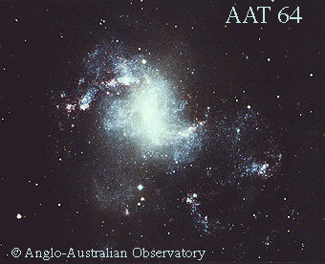
Types of Galaxies
Elliptical —shaped like large 3-D ellipses
Most common
Some small, some as large as our whole Local Group
Spiral —have spiral arms winding out from the center
Milky Way
Irregular —just don’t fit any shape
Probably made by galaxy collisions

Slide 23
Expansion of the Universe
The universe is expanding!!!
Evidence (courtesy of Edwin Hubble)
All galaxies are moving away from us
Farther galaxies are moving away faster
How do we measure this?
Doppler shift —waves scrunch together ahead of a moving object, spread out behind

