Slide 1
AIR QUALITY
Natural Pollutants
VOLCANOES – SO, particulates
FOREST FIRES – CO, CO2, NO, particulates
WINDSTORMS - dust
PLANTS(LIVE) – hydrocarbons, pollen
PLANTS(DECAYING) – methane gas, H₂S
SOIL – viruses, dust
SEA – salt particles

Slide 2
Anthropogenic Pollutants – Human activity products – very concentrated.
Carbon monoxide – CO Vehicles
Sulfur oxides – SO_{x} Industry
Nitrogen Oxides – NO_{x} Vehicles
Particulates – PM’s Vehicles, Industry
Hydrocarbons – HC’s Vehicles, Industry
Photochemical oxidants – Formed from the reaction of light and HC and NO. Ground level Ozone (O₃), Formaldehyde, and Peroxyacylnitrate (PAN) are a few examples. Vehicles, Industry

Slide 3
HUMAN IMPACT
Altering natural balance of cycles in the atmosphere
Add ¼ more carbon dioxide
Burn fossil fuels releasing NOx into air = more acid rain (nitric acid)
Add sulfur from burning coal and refining petroleum = more acid rain (sulfuric acid)
Heavy metals –
1. 2X the arsenic as nature
2. 7X the cadmium
3. 17X the lead

Slide 4
3 Processes That Cause Air Pollution
1. Combustion –
Hydrocarbon (HC) + Oxygen → CO₂ + H₂O
2. Evaporation – Vaporization of any liquid.
Gasoline, Solvents, etc.
3. Friction – Rubber tires

Slide 5
Types of Pollution
Primary Pollutants – pollutants released from man-made sources that may undergo change in the atmosphere and become something more harmful.
Secondary Pollutants – may be more harmful than the chemicals from which they came from. i.e. sulfur dioxide gas mixing with oxygen and water to become sulfuric acid.

Slide 6
PRIMARY POLLUTANTS
1. CO – carbon monoxide
2. CO₂ – carbon dioxide
3. SO₂ – sulfur dioxide
4. NO – nitrogen oxide
5. NO₂ – nitrogen dioxide
6. Hydrocarbons
7. Particulates

Slide 7
SECONDARY POLLUTANTS
SO₃ – sulfur trioxide
HNO₃ – nitric acid
H₂SO₄ – sulfuric acid
H₂O₂ – hydrogen peroxide
O₃ – ozone
PAN’s – peroxyacyl nitrates

Slide 8
Effects Of Climate And Temperature On Air Pollution
Gray-Air Cities – older cities, cold moist climates. Sulfur oxides mix with moisture to create SMOG – mixture of smoke and fog. Heavily industrialized cities.
Industrial Smog
Brown-Air Cities – newer, non-industrialized cities. Mainly hydrocarbon and nitrogen oxides from automobile and electrical plant pollution. React in the presence of sunlight to form many secondary pollutants.
Photochemical Smog
These reactions are called photochemical reactions because they involve chemicals and light.

Slide 9
PHOTOCHEMICAL SMOG
Newer cities
Brown smog
Mostly ozone, aldehydes, PAN’s, and nitric
acid
Formed from the NOx from cars/factories and
volatile organic compounds (VOC’s)
These VOC’s are methane, propane, benzene,
chlorofluorocarbons (CFC’s) mixing in the
presence of sunlight.

Slide 10
Smog Chemistry
N₂ + O₂ =2NO Nitrogen oxide
engine of car and then into air to →
2NO + O₂ = 2NO₂ Nitrogen Dioxide
brown haze – choking odor to →
3NO₂ + H₂O = 2HNO₃ + NO Nitric Acid
produces acid rain and some NO₂ gases go onto →
NO₂ + UV energy = NO + O
which then go to →
O + O₂ = O₃ ground level ozone

Slide 11
Industrial Smog
Older cities
Gray air smog
Mostly sulfur dioxide and sulfuric acid as well as suspended particles (ASH)
Mostly caused by burning coal

Slide 12
Smog Chemistry
S + O₂ = SO₂ Sulfur Dioxide
then to →
SO₂ + O₂ = 2SO₃ Sulfur Trioxide
then to →
SO₃ + H₂O = H₂SO₄ Sulfuric Acid
then to →
H₂SO₄ + 2NH₃ = (NH₄)₂SO₄ Ammonium Sulfate
salt and soot give air gray color

Slide 13
Factors Affecting Air Pollution
Wind
Location
Topography
Precipitation
Temperature Inversion – normal circumstances air temperature falls around 5.5°Cfor each 300 meters increase in altitude. Pollutants rise and disperse. When a warm air lid forms over a cooler air, the cooler air cannot rise up through it. Thus the pollutants at ground level increase at ground level.

Slide 14
Acid Deposition
Acid Rain - wet acid
Acid Deposition – dry acid (solid or gas)
Natural Rain is pH 5.0 – 5.6 (without acid). CO₂ dissolved from air forms weak carbonic acid.

Slide 15
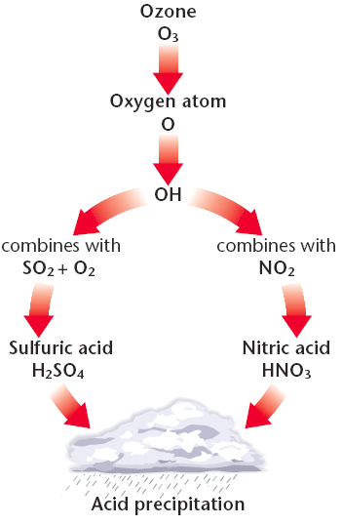

Slide 16
Acid Rain
Wet and dry deposition due to secondary pollutants
pH of 4.6 in Eastern US – regional problem
buffering soil is good – limestone based
5.6 and below is dangerous – adding lime is least effective

Slide 17
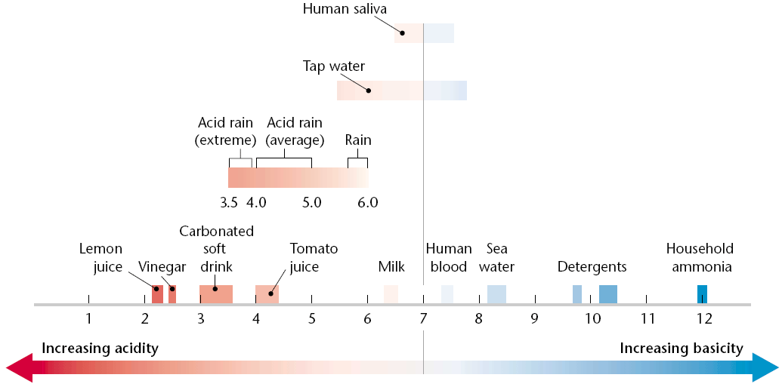

Slide 18
Acid Associated Problems
Humans – bronchitis, asthma
Buildings – premature aging
Trees – weakens leaves, tree becomes vulnerable to pests.
Soil – releases metals (toxic) which kill fish when metals run off into water.
Areas affected are usually downwind from industrial areas or dense urban zones.
Vegetation and aquatic life receive the most damage.

Slide 19
Acid Prevention and Protection
Natural buffers in soil, Calcium (Ca⁺²) and Magnesium (Mg⁺²) can react with and neutralize acids.. Thin soils offer no buffer protection.
Reduce energy use.
Switch from coal to cleaner energy source.
Remove sulfur from coal before burning.
Remove SO₂, NO_{x}, and particulates from smokestacks with use of scrubbers.
Remove NO₂ from car exhaust.

Slide 20
Ozone – O₃
Beneficial in upper atmosphere (stratosphere) – decreasing
Harmful in troposphere (ground-level) – increasing
Causes respiratory problems at ground level
SMOG – ozone contributor at ground level
Only pollutants not reduced in past 30 years – ground level ozone

Slide 21
Ozone – O₃
Atmospheric Ozone is depleted by CFC’s
Chloroflorocarbons found in:
1. Refrigerants
2. Fire extinguishers
3. Plastic foam containers
4. Air conditioners

Slide 22
Ozone – O₃
Cl + O₃ → ClO + O₂
ClO → Cl + O
Free Chlorine (Cl) will continue as a catalyst and destroy 100,000’s of ozone molecules.
Protects us from harmful Ultra violet (UV)rays from the sun
Damage from UV rays include skin cancers, egg formation in aquatic life, and decreases in photosynthesis in plants.

Slide 23
Toxicity
Acute – short term – lung irritation, inflammation of respiratory tract, eye irritation, dizziness.
Chronic – long term – emphysema, bronchitis, heart attack
Perceived risk – Greater than actual risk. Protection is legislated or mandated.
Actual risk – Risk is greater than perceived risk. We are generally not concerned

Slide 24
Toxicity
Toxicity measures how harmful a substance is in causing injury, illness, or death.
Factors that deal with toxicity:
Dose
Frequency of exposure
Age and size of exposed individual
Health of detoxification system (liver, etc.)
Genetic make-up

Slide 25
5 factors that can affect the amount of harm a substance can cause
Solubility – Water or fat soluble
Persistence – Some toxins break down, some remain
Bioaccumulation – Molecules are stored in body.
Biomagnification – Accumulate at greater levels as you go up food chain
Chemical Interactions:
Antagonistic – One chemical negates effect of another
Synergistic – One chemical multiplies effect of another.

Slide 26
Indoor Air Pollution
CO - dizziness, headache, heart attack
asbestos - lung cancer
NO - lung irritation, asthma
trichloroethane - aerosols, dry cleaning
radon - gas from U-238 breakdown
tobacco smoke - lung cancer, bronchitis, emphysema
formaldehyde - particle board, furniture
styrene - carpet, plastics

Slide 27
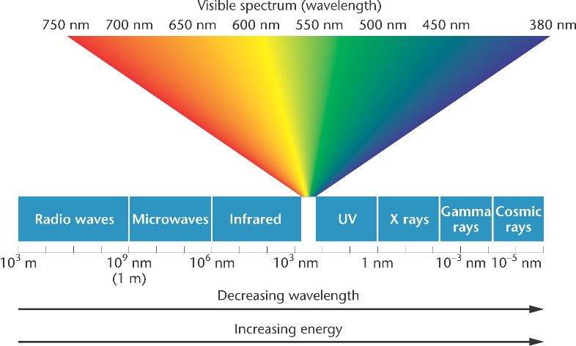
Electromagnetic Spectrum

