Slide 1
A Funny Taste
Directions: Fill in the left side of the following chart with your predictions on which body of water has the lowest salinity (1) to the highest salinity (7). Then fill in the right side of the chart based on the class discussion.
Prediction | Body of Water | Actual Salinity | Density
 | Distilled
 | The Dead Sea
 | The Oceans
 | Baltic Sea
 | Red Sea
 | Black Sea
 | Great Salt Lake

Slide 3
Salt ‘n Lighter
Directions: Fill in the left side of the following chart with your predictions on which solution will cause the egg to float and which will cause the egg to sink. Then fill in the right side of the chart with your observation.
As salinity of water increases, the density increases.
Egg will float if the weight of the egg is less than that of the water.
Prediction | Solution | Observation
 | No salt
 | 35 grams of salt
 | 290 grams of salt

Slide 4
Diet Light
Directions: Fill in the left side of the following chart with your predictions on whether the can of regular coke and the can of diet coke will sink or float in water. Then fill in the right side of the chart with your observation.
Objects float if they weigh less than the weight of the water they displace.
Objects will sink if they weigh more than the weight of the water they displace.
Prediction | Can of Soda | Observation
 | Coke
 | Diet Coke

Slide 5
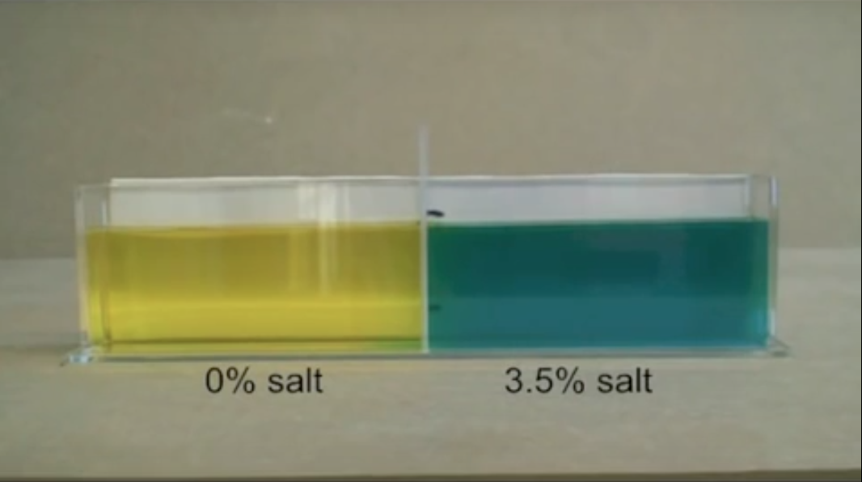
Different Salinities Layer or Mix?
Directions: Make a prediction on whether the different solutions will mix or layer in the water. Then draw a picture of your observation.
Prediction:
Observation:
https://www.youtube.com/watch?v=7fqOtgG6vik

Slide 6
Different Temperatures Layer or Mix?
Directions: Make a prediction on whether the different solutions will mix or layer in the water. Then draw a picture of your observation.
Prediction:
Observation:
https://www.youtube.com/watch?v=Ak9CBB1bTcc

