Slide 1
Ocean Salinity
Unit: Oceanography

Slide 2
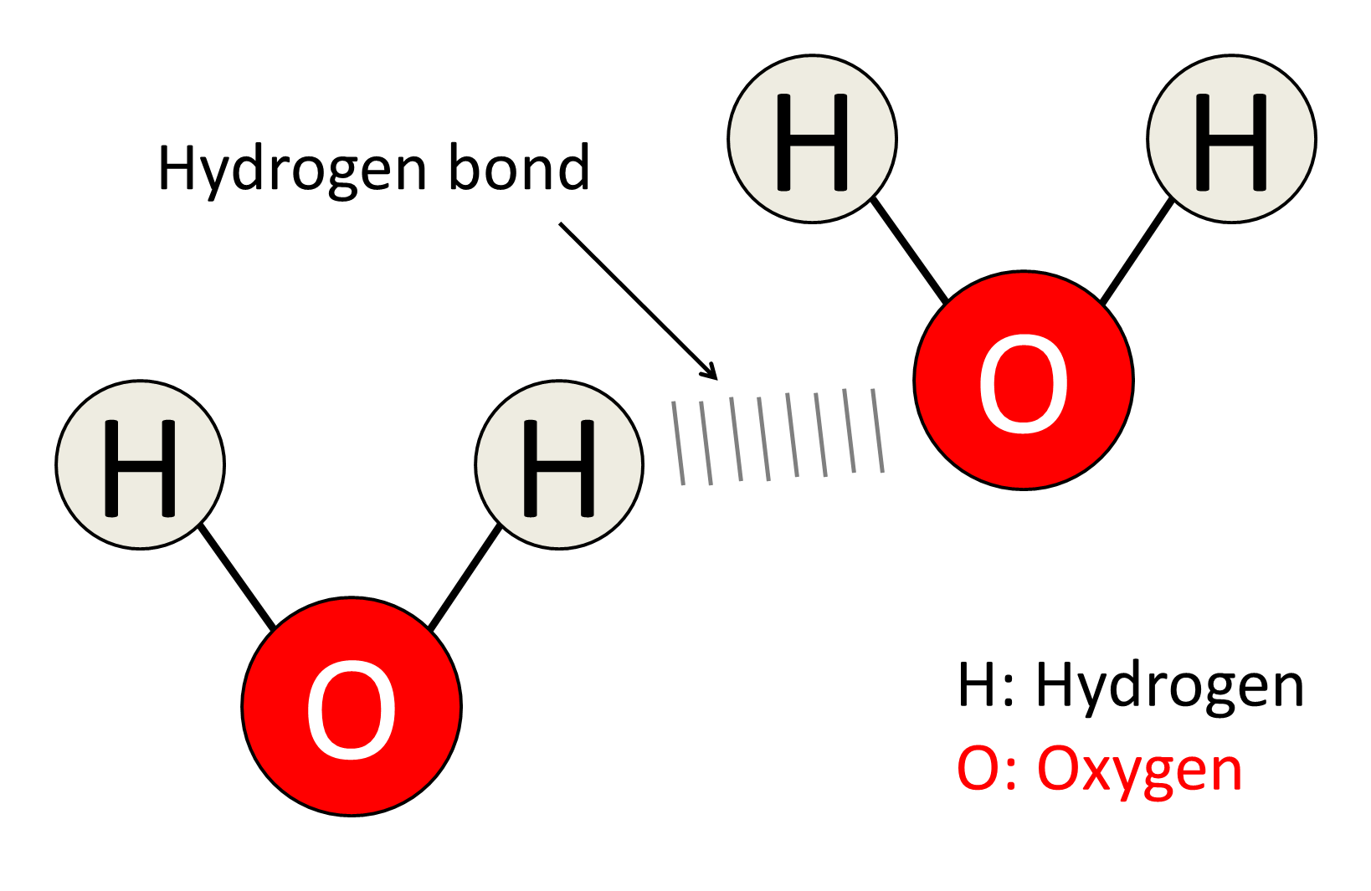
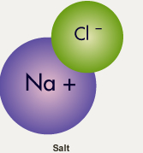
What are the most common elements in sea water?
Water
Salt
Oxygen
Hydrogen
Sodium
Chlorine

Slide 3
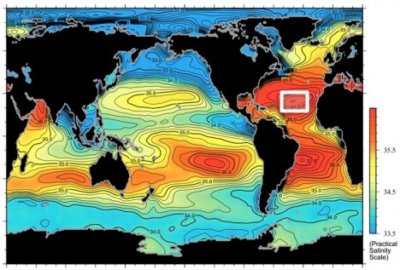
Areas of High and Low Salinity
Of the five ocean basins, the Atlantic Ocean is the saltiest.

Slide 4
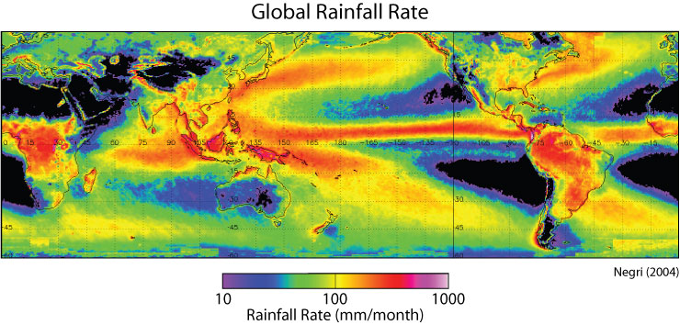
Salinity Near the Equator
How much rain does the tropical biome receive?
What does this rain do to the water?
The tropics receive the most rain, the fresh water falling into the ocean helps decrease the salinity of the surface water

Slide 5
Salinity Near the Poles
How much rain does the polar region receive?
What does this lack of rain mean for the salinity of the water?
At the poles, rain decreases
With less rain and more sunshine, evaporation increases

Slide 6
Salinity Near the Poles
What is the salt content of the ice caps in the polar region?
What does the melting of the ice caps mean for the salinity of the water?
Melting of the ice caps causes a decrease in the surface salinity.

Slide 7
The Saltiest Locations
The saltiest locations in the ocean are:
Regions where evaporation is highest
In large bodies of water where there is no outlet into the ocean.
The Red Sea and Persian Gulf contain the saltiest ocean water due to very high evaporation and little fresh water inflow.

Slide 8
Temperature and Salinity
As temperature decreases to 40ºF (4ºC) the molecules slow, water contracts and the density increases
Below 40ºF the molecules begin to bond to each other and as they do, the water begins to expand again, decreasing the density

Slide 9
Temperature and Salinity
At 32ºF (0ºC) all molecules are locked into a crystalline structure with a resulting 9% expansion in size
This expansion, and corresponding decrease in density, is the reason ice floats.

Slide 10
Temperature and Salinity
Adding salt to water lowers the freezing temperature
Water with a salinity of 17‰ freezes at about 30°F (-1°C)
35‰ water freezes at about 28.5°F (-2C)
Sea ice contains very little salt (about 1/10th the amount of salt that sea water has). Why?
Ice does not include sea salt in its crystal structure.

Slide 11
Temperature, Salinity, and Density
As the temperature of sea water decreases the density increases.
As the salt content of sea water increases, its density increases.
This makes the density of sea water, unlike fresh water, below the freezing point.

Slide 12
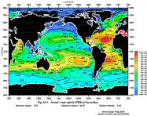
Average Salinity
Lowest salinity in the polar regions. Why?
Image depicts surface salinity only
Notes:
Polar regions have a lower salinity than the tropical regions due to melting each summer. However, each winter below the ocean surface, the increased salinity in the water due to ice formation, causes the water below the ice to sink and that sinking motion governs the motion of the ocean’s deep water currents.

