Slide 1
Movement of Air
Atmosphere

Slide 2
Movement of Air
Wind is the movement of air from high pressure to low pressure
Named for direction they come from
Cold air near poles sinks and spreads (pushing less dense, warmer air up)
Coriolis effect
Northern hemisphere – clockwise
Southern hemisphere – counterclockwise

Slide 3
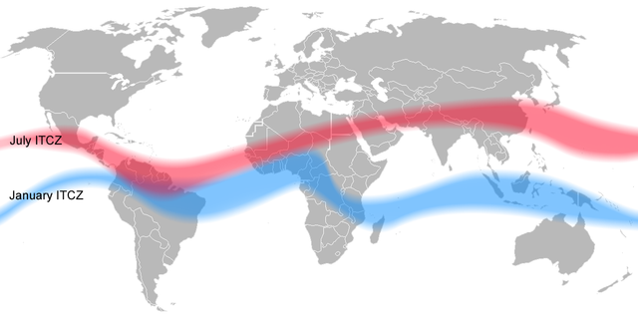
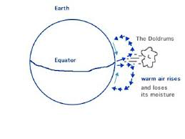
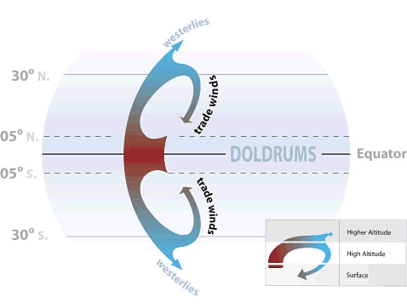
Doldrums
Doldrums – windless area near equator
Hot air just rises straight up
Trapped many sailing ships
Positions change with the seasons based upon the Earth’s position relative to the sun.

Slide 4
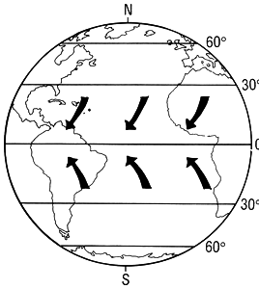
Trade Winds
Trade winds – major winds in the tropics that move toward equator and west
Provided dependable trade routes from Europe

Slide 5
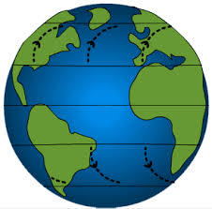
Westerlies
Prevailing westerlies —between 30° and 60° latitude, opposite direction of trade winds (they come from the west)
Took sailors back to Europe
Causes most weather patterns in USA

Slide 6
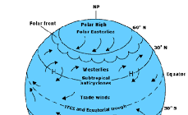
Polar Easterlies
Polar easterlies —near poles, winds move toward equator and west (from the east)
Dry, cold winds

Slide 7
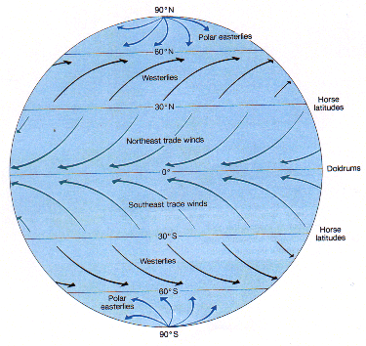

Slide 8
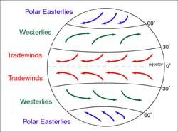

Slide 9
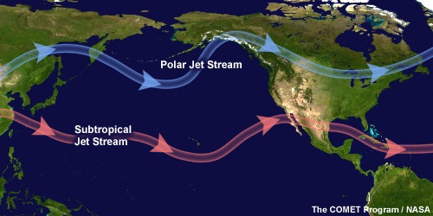
Jet Stream
Jet stream —narrow belts of strong winds near top of troposphere
60 mph to 110 mph
Helpful to jet pilots, if used well

Slide 10
Daily Winds
Change predictably during the day
Sea breeze – wind comes in from the sea during the day
Land is warmer than sea
Land breeze – wind goes out from the land during the night
Land is colder than sea

Slide 11
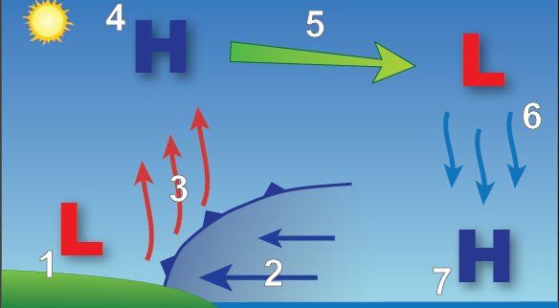
Sea Breeze

Slide 12
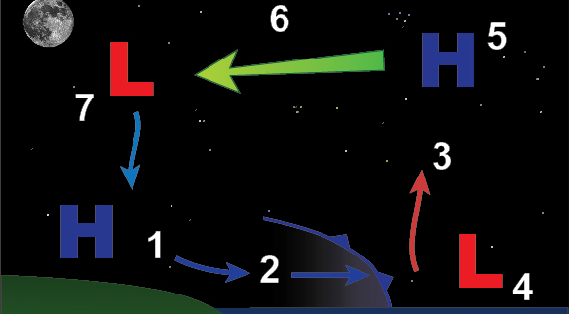
Land breeze

Slide 13
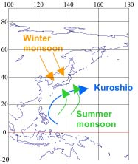
Seasonal Winds
Change direction predictably with the seasons
Monsoon winds over India bring moist air in from sea in summer
Bring intense, prolonged rain (wet season)
Reverses in winter (dry season)

