Slide 1
The ability for the ocean to absorb and store energy from the sun is due to…
The transparency of the water that allows the sun’s ray to penetrate deep into the ocean.
Constant turbulence from wind and weather mixes the water, distributing surface heating throughout
Notes:
In clear, tropical water light can reach a depth of 500-650 feet (150-200 meters) meaning that it takes a great amount of heat to raise the temperature through such a large volume of water.
In contrast to the ocean the sun's rays do not to penetrate deep into the earth but are confined to the top few inches of soil. Consequently, temperature fluctuations between daytime and nighttime are much greater over land than over water. For coastal areas, this difference of heating can have a large impact on the weather by the formation of the sea and land breezes.

Slide 2
Sea Breeze Circulation
Composed of two opposing flows
One at the surface (called sea breeze)
One aloft (a return flow)
Two flows are a result of the difference in air density between the land and sea caused by the sun’s heating.

Slide 3
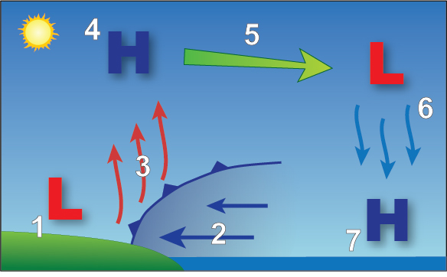
Air begins to cool
Air cools, density increases, sinks toward Earth.
Density differences causes air to flow back over water
Less dense air rises.
Enhanced high pressure near ocean’s surface.
Thermal Low
Cooler, more dense air spreads inland
Notes:
Sun Warms ground and ocean at the same rate. Ground’s heat remains confined to the top few inches of soil and radiates back into the atmosphere warming the air. As the air warms, its density decreases creating a weak low pressure area called a “thermal low”
The cooler, more dense air from the adjacent water, being pulled down by gravity, begins to spread inland.
Inland push of air from the ocean undercuts the less dense air over land forcing it to rise. A sharp boundary (called a sea breeze front) develops due to the large difference between the air temperature over land and over water. This acts in the same manner as the cold front we typically experience.
Over land, air forced up by the sea breeze front will begin to cool (cooling means the density increases again forming a small area of high pressure). Occurs from 3,000 to 5,000 feet in elevation.
At this level the air pressure and density, being greater than the same elevation over the water, causes air to flow back over water.
Air cools, increases in density and sinks toward the earth’s surface
Enhances high pressure near the ocean’s surface.
Process repeats

Slide 4
Steps of Sea Breeze
Sun warms ground and ocean, ground’s heat radiates into atmosphere, warming air. As air warms, density decreases creating a weak low pressure area called a “thermal low”
The cooler, more dense air from water, spreads inland.
Air from ocean undercuts less dense air over land forcing it to rise.
-Sea breeze front - develops due to the large difference between the air temperature over land and over water
Air begins to cool, density increases, forms small area of high pressure (Occurs from 3,000 to 5,000 feet in elevation.)
High pressure/density air flows back over water (where there is low air pressure/density)
Air cools, density increases, air sinks toward the earth’s surface
Enhances high pressure near the ocean’s surface.

Slide 5
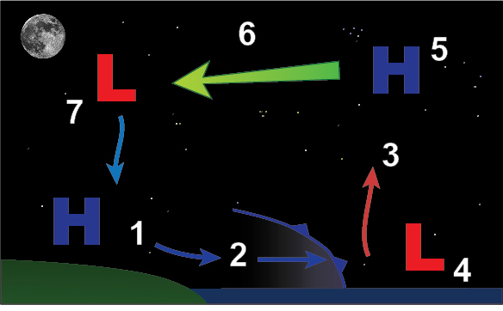
Notes:
Land temperature falls below ocean temperature resulting in increase in air’s density. Gravity’s pulls dense air offshore.
More dense air undercuts the lighter, warmer air over water.
Forces air up into the atmosphere
Raising air from a weak low pressure area.
Rising air accumulates aloft forming an area of higher pressure
Air flows back toward land from high pressure to low pressure
Air cools, increases in density, then sinks causing an increase in density and high pressure.

Slide 6
Land Breeze
Land temperature falls below ocean temperature resulting in increase in air’s density. Gravity’s pulls dense air offshore.
More dense air undercuts the lighter, warmer air over water.
Forces air up into the atmosphere
Raising air from a weak low pressure area.
Rising air accumulates aloft forming an area of higher pressure
Air flows back toward land from high pressure to low pressure
Air cools, increases in density, then sinks causing an increase in density and high pressure.

Slide 7
Land Breezes Weaker than Sea Breeze
At night:
Cooling ground inhibits vertical motion which weakens the land breeze circulation
Nighttime cooling produces a shallower change in temperature so land breeze circulation is shallower
Terrain, vegetation, and buildings inhibit the flow of air from land to water.

Slide 8
Marine Layer
Represents a difference between a cool, moist airmass and a warmer airmass.
Can persists for days and weeks along the west coast, particularly Southern California.
Depth depends on the large scale weather patterns that pass overhead
Notes:
The reason is the water along the west coast of the United States comes from the Gulf of Alaska and is much cooler than at the same latitude along the east coast where the Gulf Stream brings tropical water north. The surface temperature of the water off the California coast can be as much as 30°F (17°C) or more lower than at the same latitude on the east coast. The colder water means the air in contact with the water is colder and therefore is more dense.
When the air well above the water is warmer than the water, as it is normally for all seasons except winter but most common in late spring/early summer, a temperature inversion develops, where instead of the air cooling with increasing elevation the air actually increases in temperature with height. The cooler air below the inversion is called the marine layer and is cooled to the point at which clouds form. Because of its persistence in early Summer, the people in Southern California it is often refer to it as the "May Gray" or "June Gloom".

Slide 9
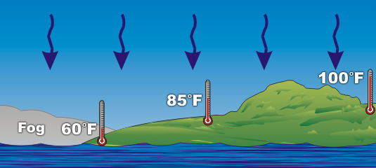
Marine Layer and High Pressure System
High pressure systems tend to squish the marine layer down near the surface
Coastal clouds and foggy weather is confined to beaches with warm, sunny conditions beginning a mile or so inland.

Slide 10
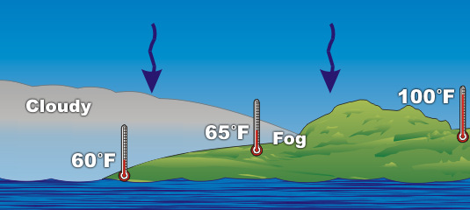
As high pressure decreases in strength
Downward force decreases allowing marine layer to penetrate farther inland
Flog lifts at the beach to a lower cloud deck
Further inland, fog is located at the leading edge of the inland push of the cooler air.
Notes:
Clouds are located near the top of the marine layer

Slide 11
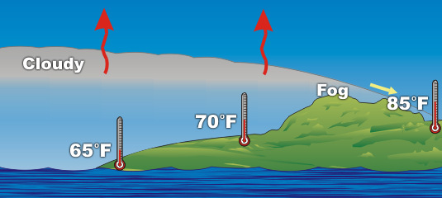
Marine Layer and Low Pressure System
Marine layer is allowed to deepen as much as 6,000 feet
Fog is confined to mountain tops and passes
Air begins to warm at lower elevations as it is modified by the heat rising from the ground.
Cooler air moves over coastal mountains and through the passes into the interior valleys.

