Slide 1
Weather
Atmosphere

Slide 2
What is weather?
Weather is the present state of the atmosphere
This includes:
Air pressure
Wind
Temperature
Humidity

Slide 3
What is humidity?
Humidity is the amount of water in the air
Relative Humidity – the amount of water in the air compared to how much it could hold
Warm air can hold more water than cold air
Saturated – 100% humidity

Slide 4
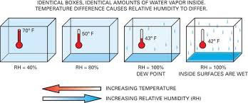
What is Humidity?
Dew point – temperature at which air is saturated and condensation occurs

Slide 5
Clouds
Clouds are small drops of water floating in air – formed as warm air is forced up, and the water vapor cools
Water vapor collects around small particles of dust, salt, and smoke (called a cloud nuclei)
Classified by shape and height

Slide 6
Precipitation
Rain | Drops of water; fall when air is above freezing
Snow | Ice crystals form in clouds
Sleet | Snow passes through warm air, melts, then refreezes near the ground
Hail | Recycled sleet gathering additional layers of ice

Slide 7
Precipitation

Slide 9
Clouds – Stratus
Form smooth, grayish layers; made when air cools below dew point
Form at low altitudes
Bring light drizzle
When air is cooled and condenses near ground – called fog

Slide 10
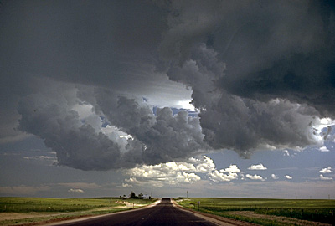
Clouds - Nimbus
Dark clouds associated with precipitation
Saturated with water

Slide 11
Clouds – Cumulous
Puffy white clouds with flat bottoms
Formed when air currents rise
Large ones are major storm clouds (cumulonimbus)

Slide 12
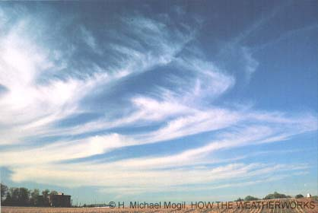
Clouds – Cirrus
Thin, high, white and wispy looking
Made of ice crystals
Associated with fair weather

Slide 14
High Level - Cirrus
Detached clouds
White, delicate filaments, mostly white patches or narrow bands
Have fibrous (hair like) and/or silky sheen appearance.
Composed of ice crystals
Before sunrise and sunset, they will appear bright yellow or red
Notes:
Transparency depends on the degree of separation of the crystals.

Slide 15
High Level - Cirrocumulus
Thin, white patch, sheet, or layered of clouds without shading
Composed of very small elements in the form of more or less regularly arranged grains or ripples.
Appears about the size of the little finger at arm’s length

Slide 16
High Level - Cirrostratus
Transparent, whitish veil clouds with fibrous (hair-like) or smooth appearance
Never thick enough to prevent shadows of object on the ground.
Sun or moon always has a halo look to it
Notes:
An extensive form will nearly always ends by covering the whole sky

Slide 17
Mid Level - Altocumulus
White and/or gray patch, sheet or layered clouds
Composed of laminae (plates), rounded masses or rolls
Partly fibrous or diffused and may or may not be merged
Appear larger than the little finger and smaller than three fingers together at arms length
When in front of the sun or moon a corona appears
Most common mid cloud.
More than one layer can be seen at different levels at the same time.
Will appear with other cloud types
Notes:
When in front of the sun or moon a corona appears. This colored ring has red on the outside and blue inside and occurs within a few degrees of the sun or moon

Slide 18
Mid Level - Altostratus

Slide 19
Mid Level - Nimbostratus

Slide 20
Lower Level - Cumulus

Slide 21
Lower Level - Cumulonimbus

Slide 22
Lower Level - Stratocumulus

Slide 23
Lower Level - Stratus

